Slide 1

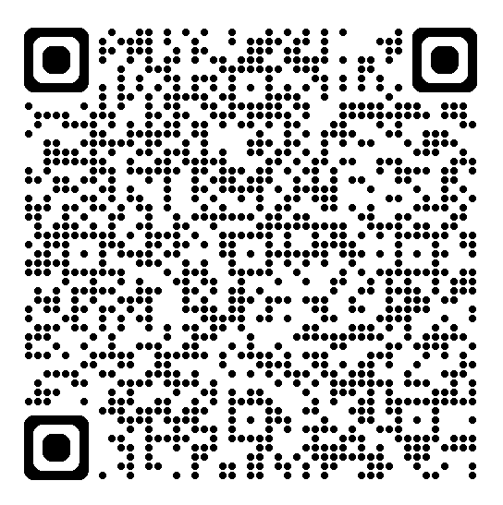
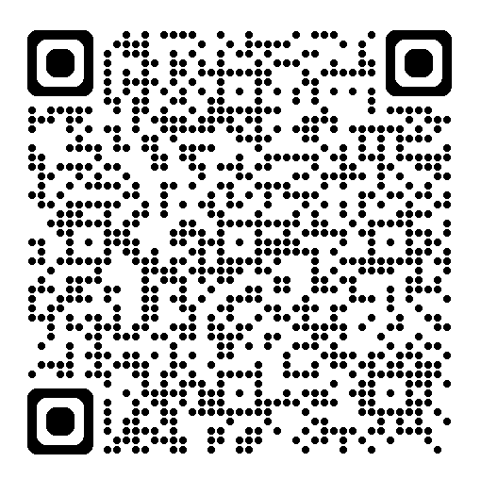
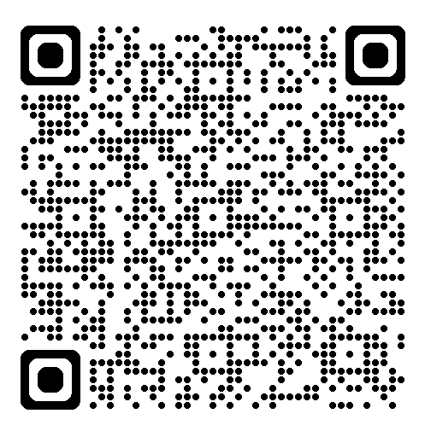

SICKLE CELL AWARENESS MONTH
September 2026
Patient Education Webinar Series
Free educational webinars for people living with sickle cell disorder, families and carers
Join one webinar or all three- simply scan the QR code next to your chosen date to join!
17 September • 6pm to 7pm
Why can my pain persist after a crisis? Helping you stay in control
Dr Rishi Khanna and Dr Ollie Hart
https://events.teams.microsoft.com/event/a877a03a-e39c-45b2-821f-4b29795f445e@37c354b2-85b0-47f5-b222-07b48d774ee3
24 September • 1pm to 2pm
Mind and body mental wellbeing and sickle cell disorder
Liz Roberts and Sheena Au-Yeung
https://events.teams.microsoft.com/event/562283db-e684-4c96-9f9c-c1ea7b845555@37c354b2-85b0-47f5-b222-07b48d774ee3
29 September • 6pm to 7pm
Current treatment options for sickle cell disorder
Dr Clare Samuelson, Dr Emma Astwood and Susie McKeown-Wade
https://events.teams.microsoft.com/event/9047b703-cb49-4e63-86a6-6166dcd0b32f@37c354b2-85b0-47f5-b222-07b48d774ee3
More webinars will be announced soon.
Visit our events page for the latest updates:-
https://www.ney-hcc.co.uk/events/

