Slide 1

Sickle Cell Disorder
Patient Education Event
21st June 2025

Slide 2
What Is Sickle Cell Disease?
Dr Emma Astwood
Paediatric Haematologist
Sheffield Children’s Hospital

Slide 3
To understand:
  What sickle cell disease is
  How sickle cell disease presents and why
  Possible complications of sickle cell disease
  How to manage sickle cell disease at home

Slide 4
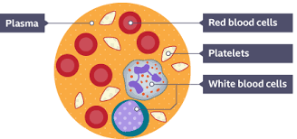
What Is Blood?

Slide 5
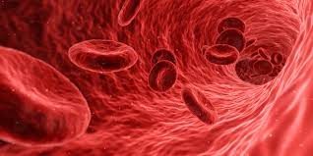
Red Blood Cells
Red Blood Cells are produced in the bone marrow in the centre of bones.
Red blood cells carry oxygen from our lungs to the rest of the body and then carry carbon dioxide from the tissues back to the lungs as a waste product to be exhaled.
Normal red blood cells live for 120 days and then get destroyed by the spleen.
Normal red blood cells are soft and tiny and squeeze through tiny blood vessels and they look like a soft doughnut.

Slide 6
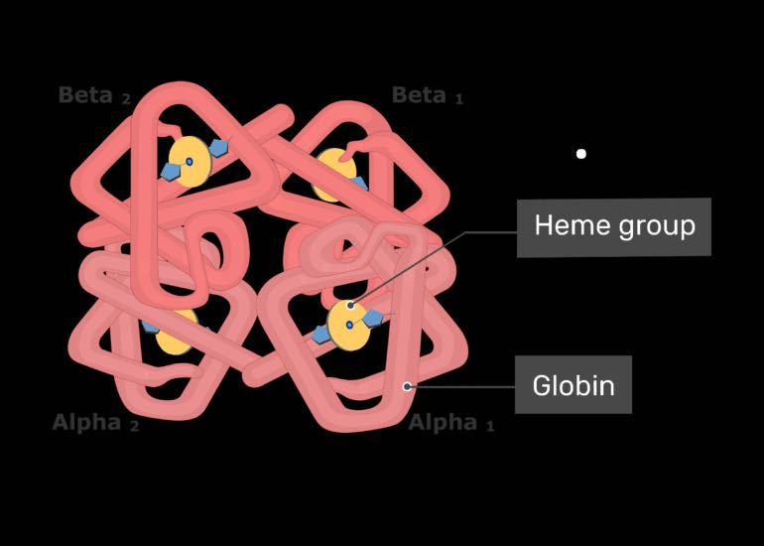
Haemoglobin
Each red blood cell contains 260-280 million molecules of haemoglobin.
Haemoglobin is a protein in the red blood cells which gives it its red colour and carries oxygen around the body.
It has 2 parts – heme and globin
  Heme – made up of iron (carries oxygen)
  Globin – proteins which join to the haem molecules (surround and protect the haem molecules)
There are different globin chains
  Alpha, beta, gamma, delta, epsilon, zeta)
The structure of each globin chain is genetically determined

Slide 7
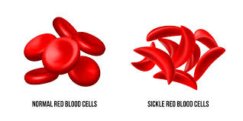
What Is Sickle Cell Disease?
A term covering a number of different but similar conditions that affect haemoglobin.
Due to a genetic change on the β globin chain which leads to a lifelong disorder affecting the red blood cells, leading to abnormal haemoglobin and rigid, sickle-shaped cells.
Types most commonly seen in UK:
  Sickle Cell Anaemia (HbSS)
  Sickle Haemoglobin C disease (HbSC)
  Sickle Beta Thalassaemia (HbS/β thal)

Slide 8
Prevalence of Sickle Cell Disease
Most people affected are of African or African-Caribbean origin, although the sickle gene is found in all ethnic groups.
It is estimated that there are 17,500 people with sickle cell disease in the UK and it is the most common genetic condition in the UK.
The prevalence of the disease is increasing in the UK because of immigration and new births.

Slide 9
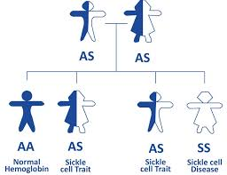
How Is Sickle Cell Disease Inherited?

Slide 10
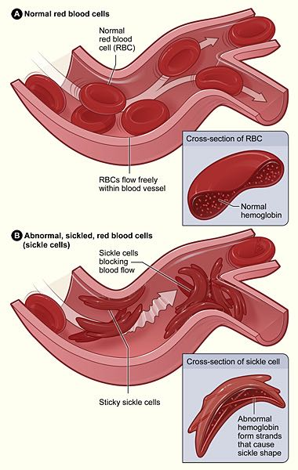
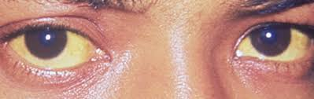
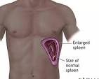
Why Does HbS Cause Problems?

Slide 11
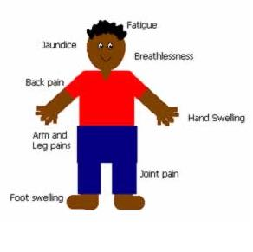
How Can Sickle Cell Disease Present?

Slide 12
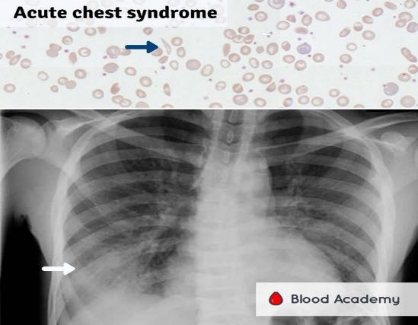
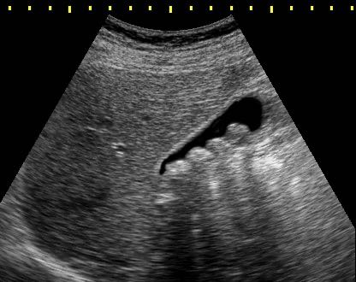
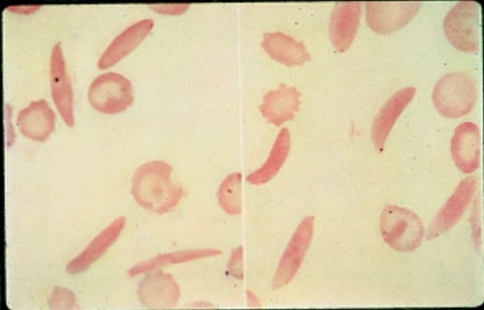
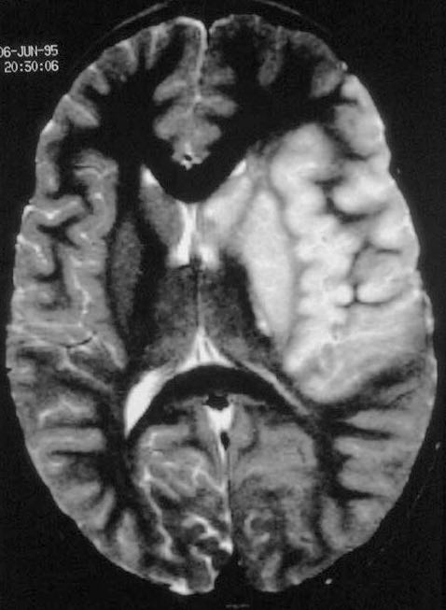
Potential Complications of Sickle Cell Disease
Enuresis
Priapism

Slide 13
How To Manage Pain At Home
Distraction techniques – read a book/ play game/meditation
Drink plenty of fluids
Keep warm – have a bath/ wheaty bags
Pain relief:
  Paracetamol +/- NSAID
  Opioid medication – codeine/morphine
If pain not resolved need to attend hospital for consideration of intranasal/ intravenous analgesia/ IV fluids

Slide 14
What can I do to help myself?
Try to keep blood flowing freely :
  Keep warm
  Keep well hydrated
General Health:
  Exercise regularly
  Eat a good diet with fruit/vegetables for all nutrients
  Try and manage stress/anxiety
Take prescribed medicines from the hospital:
  Penicillin V (to prevent infection)
  Folic Acid (to give nutrients needed to make red blood cells)
  Paracetamol/Ibuprofen if pain
Vaccinations
  Routine childhood vaccinations and additional flu vaccine/pneumococcal vaccine/Men ACWY
If unwell need to seek medical advice early

Slide 15
Why Do I Need To Come To Clinic?
To provide support with living/caring with sickle cell disease
To discuss any problems managed at home
To check bloods and ensure no damage because of sickle cell disease
To ensure growing/puberty
To examine to ensure no damage due to sickle cell disease
To discuss medications available and monitor if taking
To discuss any new advances in sickle cell disease

Slide 16

Thank you
Any Questions?

Slide 17

Your Diet Your Health: Considering Healthy Eating Principles, Habits and Behaviours
Presented by
Dr Claudine Matthews DPROF HSC RD FHEA
NE & Y Patient Education Event - Nutrition
21st June 2025

Slide 18
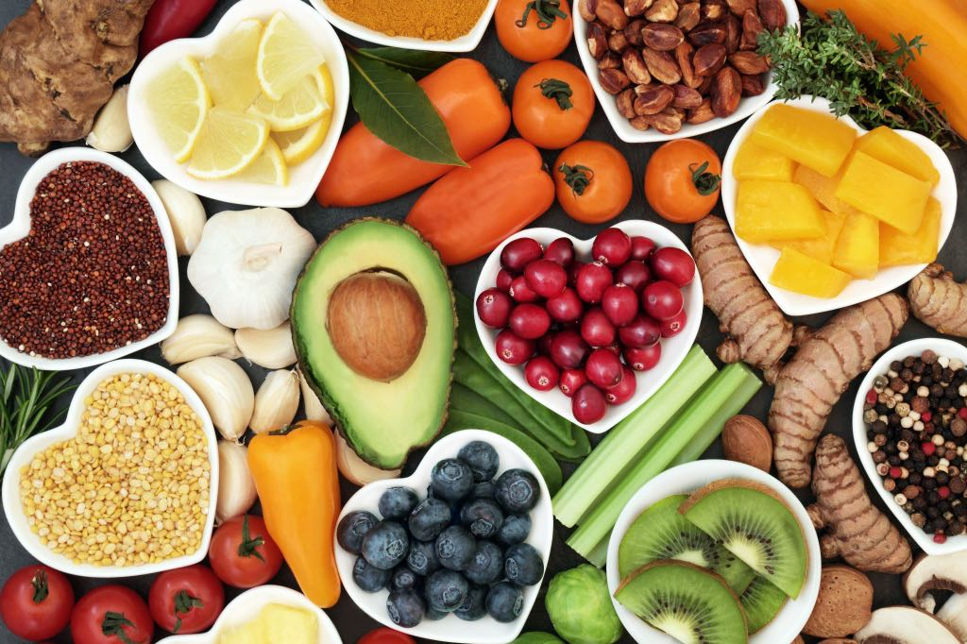
Education Session (2) Agenda:
Part 1: Why good nutrition is important: Be intentional with your diet and lifestyle choices
Part 2: The Sickle Cell Nutrition Eatwell guide – healthy principles to eat and live with
Part 3: Empowerment to improve your quality-of-life outcomes

Slide 19
Part One:
1.Why Good Nutrition is Important:
Be intentional with your diet and lifestyle choices

Slide 20
Rationale for Sickle Cell Nutrition?
Cause
  Ongoing break down of your red blood cells
  Sickle cell crisis causes tissue and organ damage
  Increased risk of infection
Impact
  Growth Delays
  Delayed Puberty
  Impaired immunity
  Increased risk of stroke
Management
  Eating a Healthy Balanced Diet
  Engage in healthy lifestyle activities like regular activity– BUT
  Don’t smoke, limit alcohol intake

Slide 21
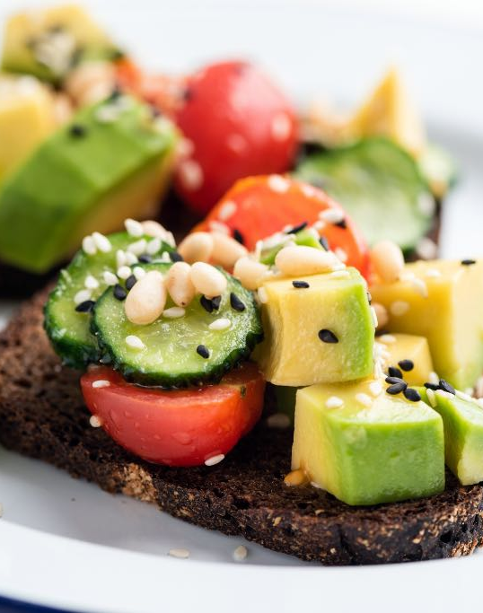
Why is good nutrition important?
Building a good nutritional status and preventing Malnutrition:
A good nutritional status is all about you –
Eating a healthy balanced diet, Healthy weight
Eating the right type and amounts of food
Choosing and eating the right variety of food
Have all the nutrients your body needs to enjoy a good quality of LIFE

Slide 22


Healthy Eating habits and Behaviours
Your Diet Your Health
  We all have a CHOICE to make
  Will it be Chicken and chips, KFC or MD’s or a HEALTHY Balanced DIET
  Knowledge is POWER
  Knowledge without ACTION is INACTION
  START EARLY to build a FOUNDATION for long term HEALTH and WELLBEING
  WHAT are you going to CHOOSE…??

Slide 23
Part Two:
2. Sickle Cell Nutrition Eatwell Guide – healthy principles to Live well with sickle cell

Slide 24
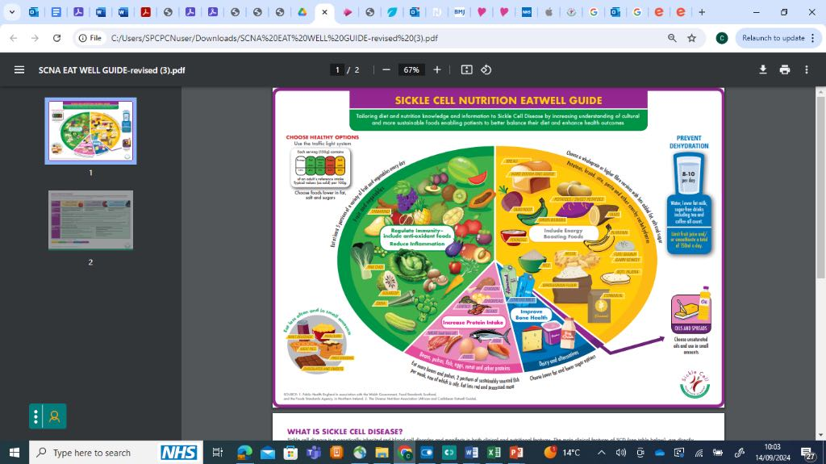

Slide 25
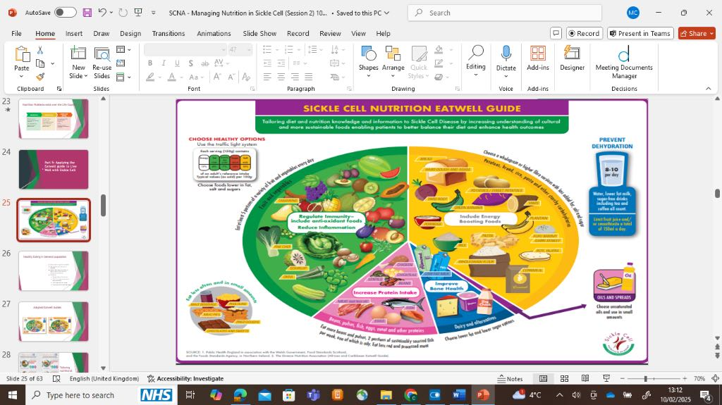
7 Key Healthy Messages in the SCD Eatwell Guide
1. Include energy boosting foods
2. Increase protein intake
3. Regulate immunity -include antioxidant foods
4. Reduce Inflammation
5. Improve bone health
6. Prevent Dehydration
7. Choose Healthy options

Slide 26
5 Food Groups
Carbohydrates (CHO)- breads, cereals, potatoes, rice, pasta, yam, plantain
Fruit and Vegetables (Your 5 a Day)
Proteins - Beans, pulses, meats and other protein, fish, eggs, other proteins
Dairy, milk and milk alternatives, cheese, yogurt
Fats and oils

Slide 27
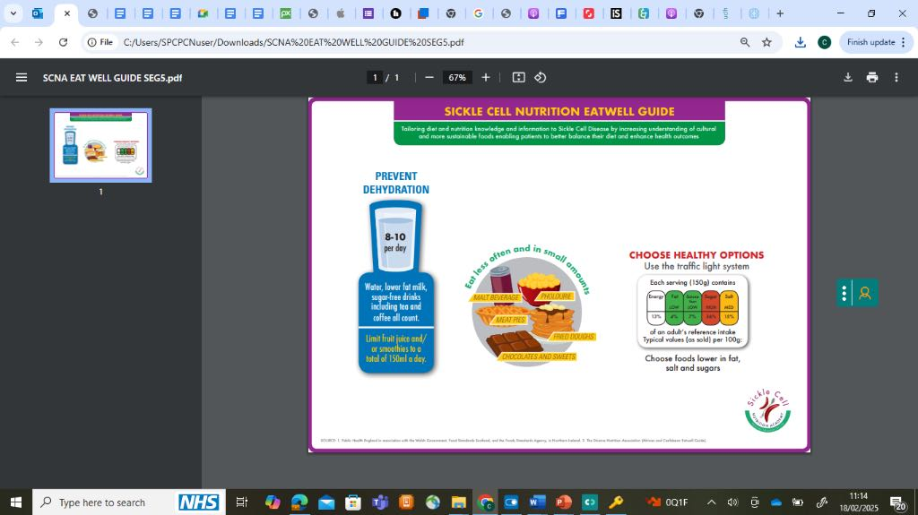
Additional Health Principles

Slide 28
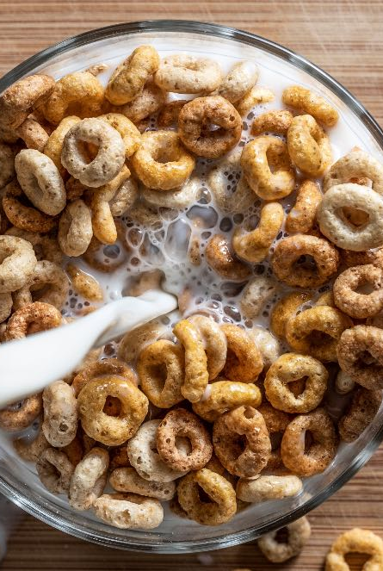


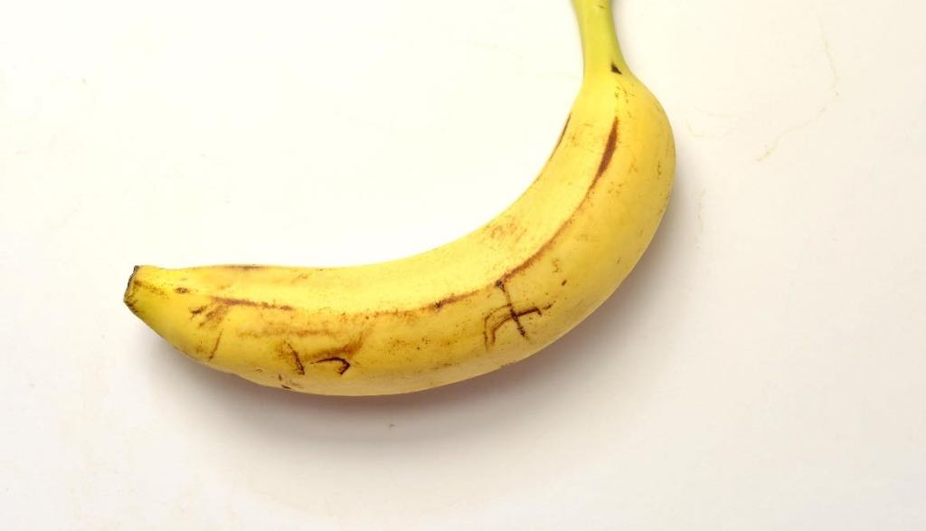
Healthy Breakfast Ideas

Slide 29




Healthy Lunch Ideas

Slide 30
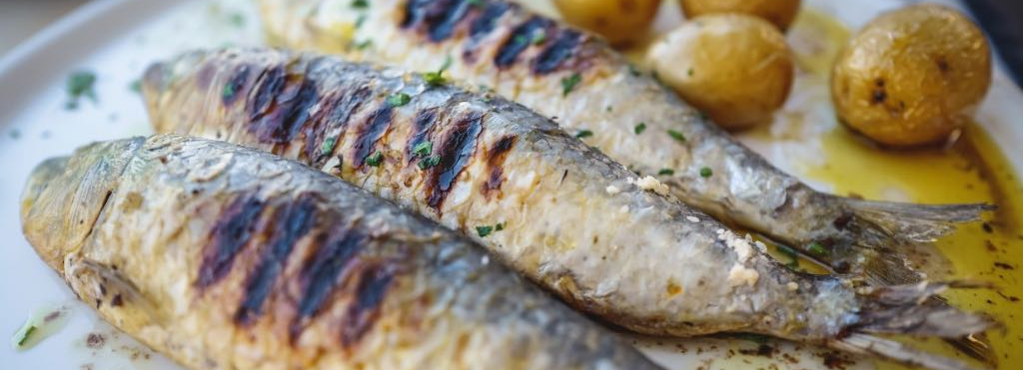
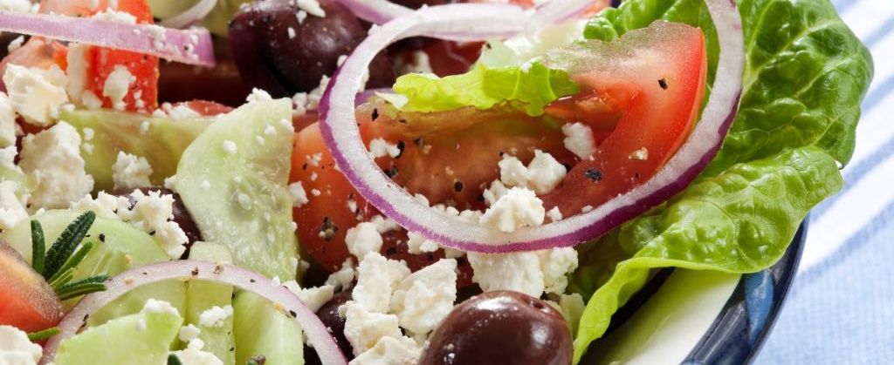

Healthy Dinner options

Slide 31
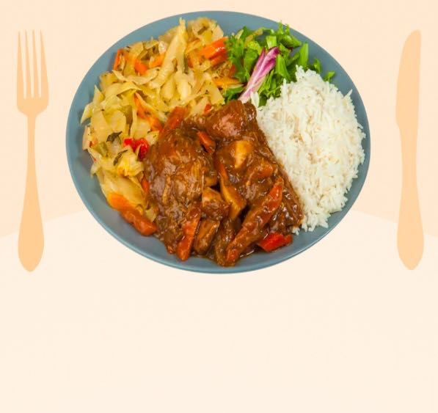

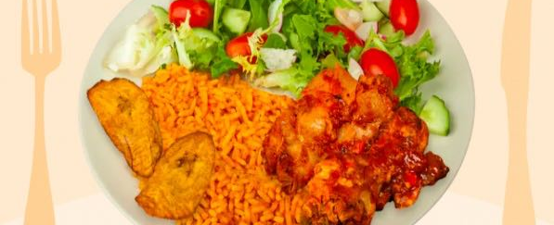

Healthy Traditional Dinner Options
Used with permission and taken from the Carbs & Cals app.

Slide 32


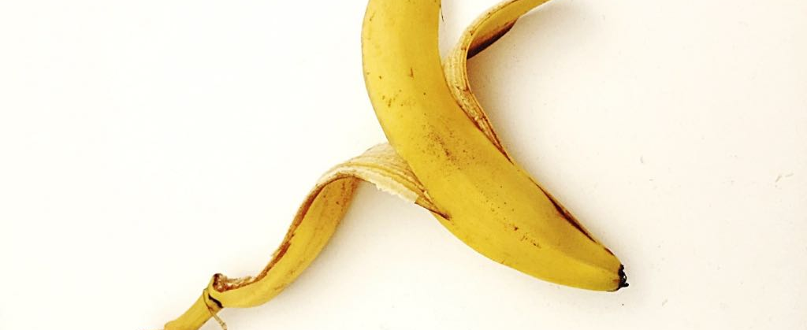
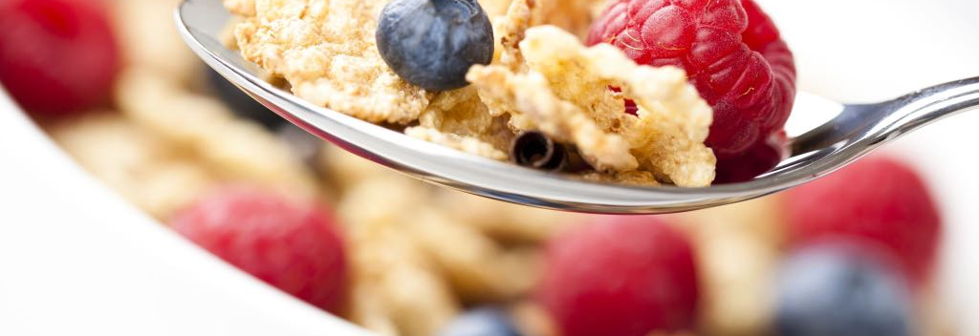
Healthy Snack Options

Slide 33
Part Three:
3.Empowerment to improve your quality-of-life outcomes

Slide 34

Factors influencing your Quality of Life
Goals (Outcomes)
Have you set goals for your health and wellbeing?
Expectations (Hopes)
What are your expectations of your health and what is influencing it?
Standards (Excellence)
What standards have you set for yourself and your Health?
Concerns (Worries)
What are your concerns and what help do you need managing it?

Slide 35
One thing you will Take Away…

Slide 36
One Take Away…

Slide 37

Thank You!
“Every closed door brings you closer to your Destiny”
Dr Claudine Matthews

Slide 38
Growing Up with Sickle Cell
What Every Girl Should Know

Slide 39
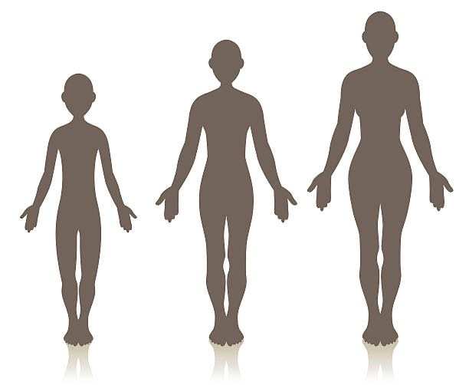
What is Puberty?
Natural body changes to adulthood
Breast development, hair growth, periods (menstruation)
Growth spurts, mood swings

Slide 40

When Should Puberty Start?
Usually between 8 and 13 years
Can be later in sickle cell
If no breast development by 14 or no periods by 16 - talk to your nurse or doctor
Everyone develops at their own pace

Slide 41
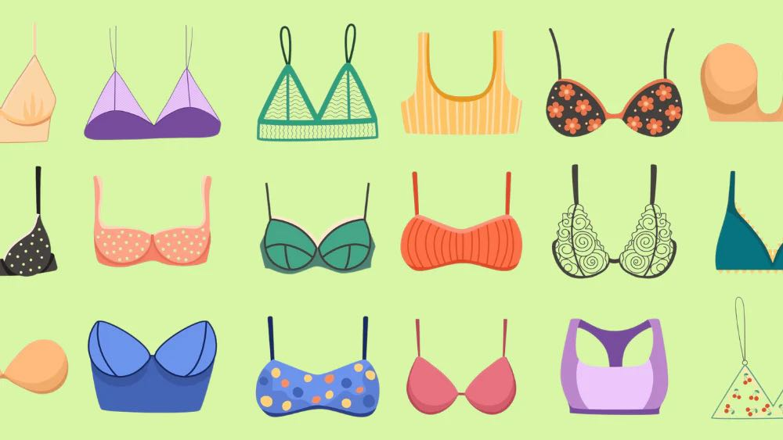
Sore Breasts
Breasts can be uncomfortable when first developing
Breast tenderness also common before periods
Helped by well-fitting bras
Consider getting measured in a bra shop (or at home)
Try padded bras if you have tenderness

Slide 42
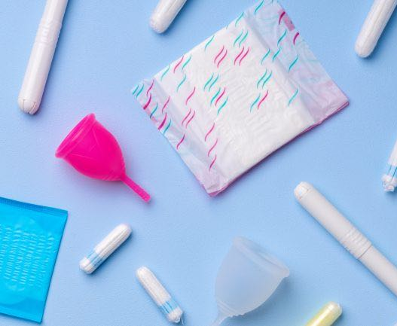
Periods – they can be a Pain!
Cramps
Heavy bleeding – see your doctor if a sanitary pad or tampon lasts less than 2 hours
Feeling tired

Slide 43
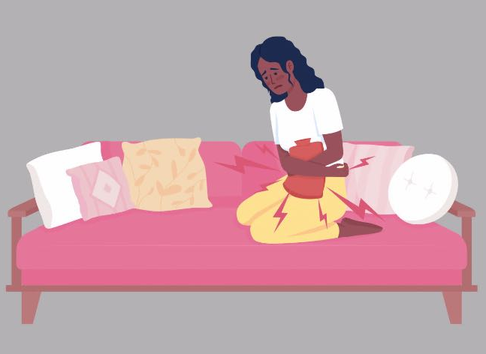
Periods can cause sickle pain
Some people have more sickle cell pain around their periods
If this happens to you, tell your nurse or doctor
Extra medication can help

Slide 44
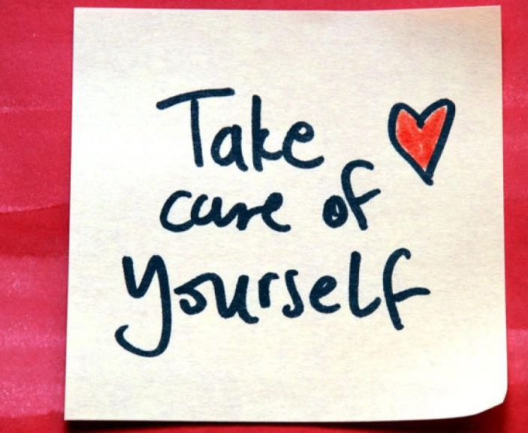
Looking after Yourself around Periods
Stay hydrated (not too much caffeine – or in the future alcohol)
Eat a healthy diet
Rest and relax
Take pain relief, hot water bottles
Talk to someone about how you feel
Hormonal medication might help if periods painful or heavy, or bring on crisis

Slide 45
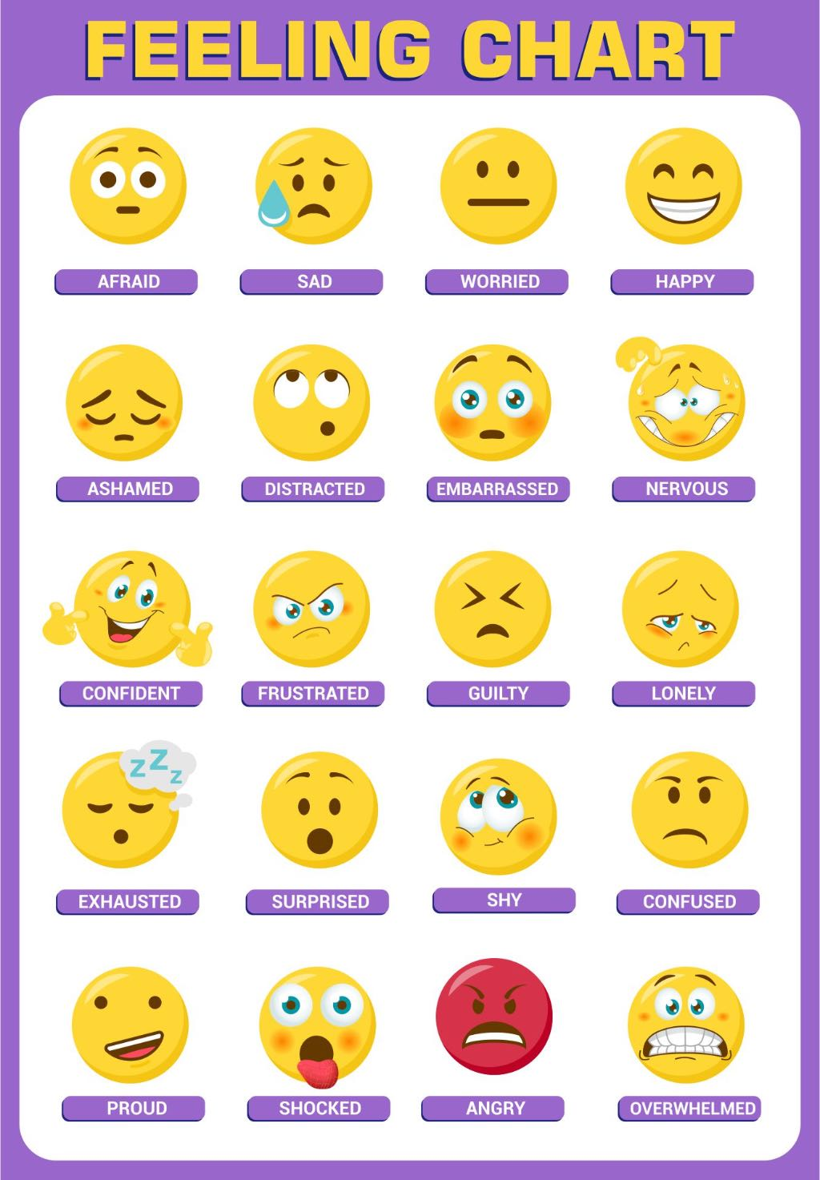

Mental and Emotional Health
Puberty brings mood changes
Periods affect your mood as well
Sickle cell can cause stress
You are not alone – talk to friends, family, nurses, doctors, psychologists, mentors
Support groups can help
Join the Sickle Cell Society

Slide 46

Fertility and Sexual Health
Most women with sickle cell can have children
Talk to your healthcare team first if you are planning to have a baby
Use contraception unless you are at a stage in life when you are trying to get pregnant
-condoms, pill, implant, injection, patch, coil etc
Only condoms protect against STIs
‘Natural methods’ of contraception are not reliable!
Best to plan a pregnancy and talk to your doctor first

Slide 47

Conclusion
Puberty with sickle cell can be different, everyone is unique
If puberty or periods are difficult – talk to someone, we can help!
Ask questions and take care of yourself ☺

Slide 48

Questions?

Slide 49

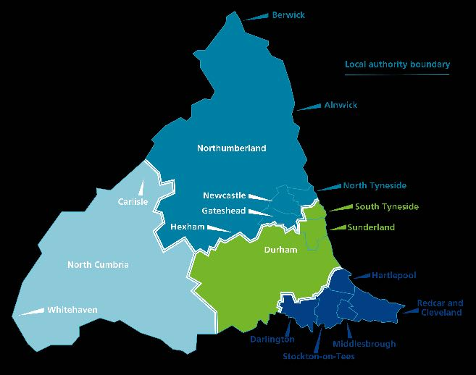
Speaker Bio
Jenni Lawrence
Children & Young People’s Haemoglobinopathy Clinical Nurse Specialist
Great North Children’s Hospital
Newcastle upon Tyne

Slide 50
Medication in Sickle Cell Disease

Slide 51
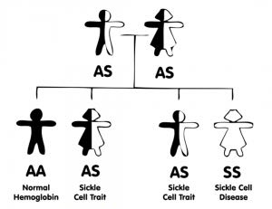
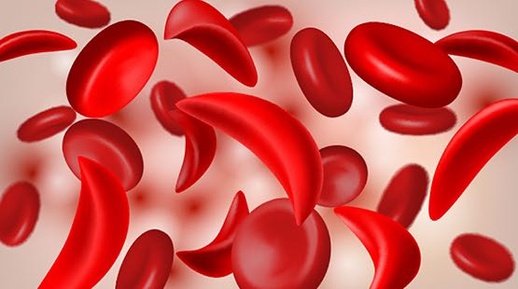
What is Sickle Cell Disease?
Inherited condition
Affects red blood cells
Haemoglobin S
Red cells change shape, get hard and sticky and block blood vessels
Red cells break more easily
Leads to pain and anaemia

Slide 52
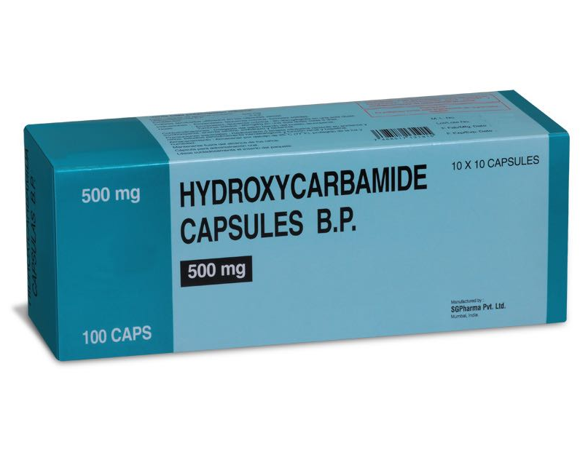
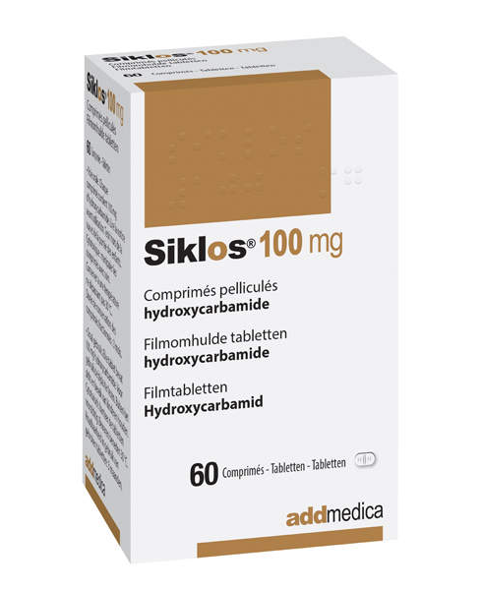
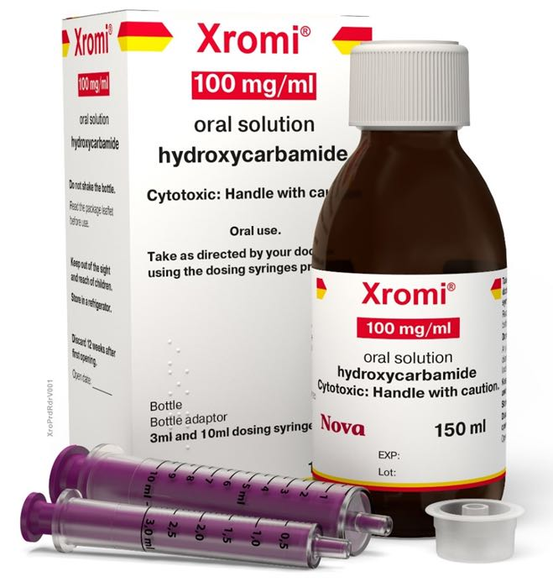
Medicines for Sickle Cell Disease
Treatment for Sickle Cell
Makes blood less sticky
Helps stop crisis
Increases HbF (Reduces HbS)
Reduces inflammation
Works over a long time
Few side effects

Slide 53
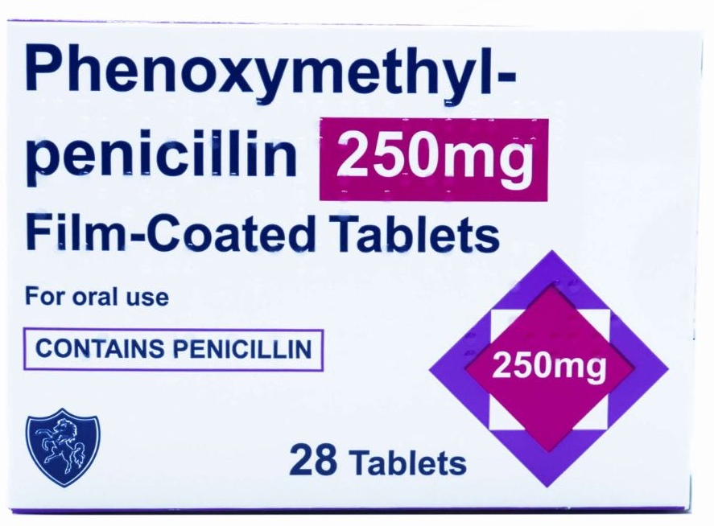
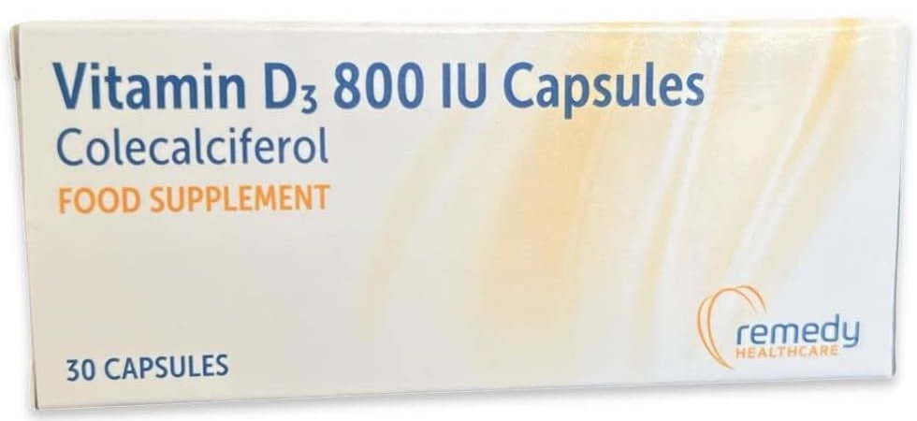
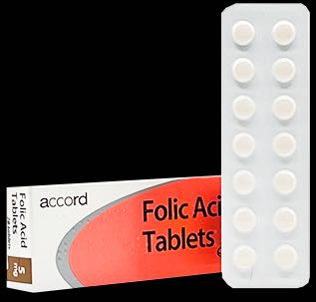
Medicines for Sickle Cell Disease
Vitamin
Can be found in food
Helps to make blood cells
Vitamin
Can be found in food
Helps keep bones healthy
Helps support immune system
Antibiotic
Taken twice a day
Helps protect against infection

Slide 54
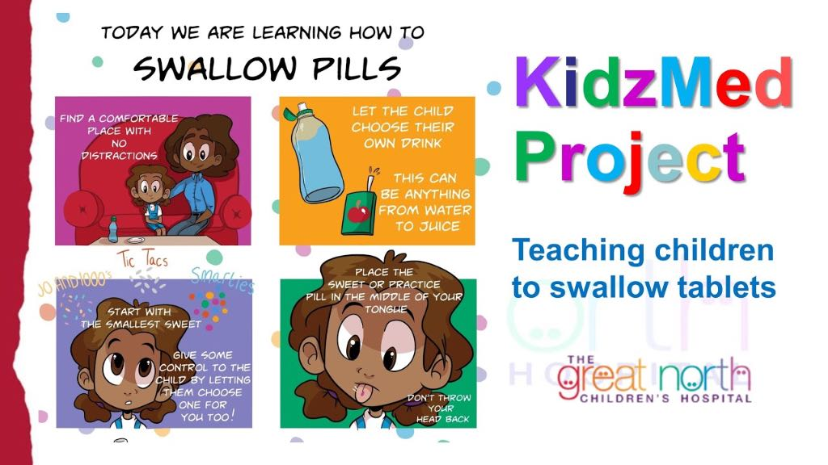
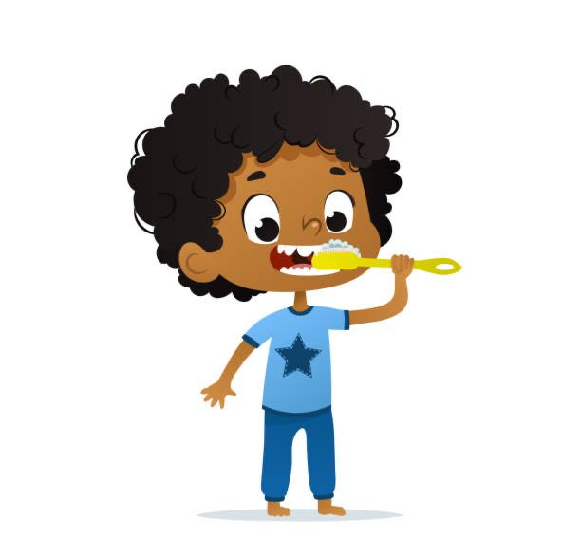
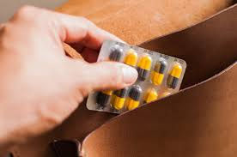
Switching to tablets
Switching to tablets from liquid medication is good for lots of reasons:
Easier to carry
Doesn’t need to go in the fridge
Longer shelf life
Some liquids don’t taste nice
Better for teeth
KidzMed can help – ask your hospital team!

Slide 55
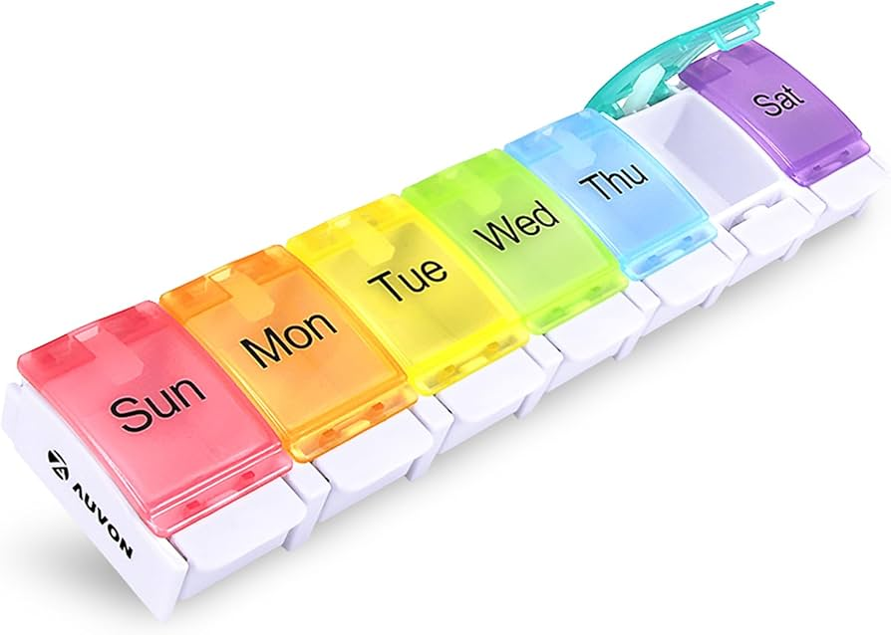
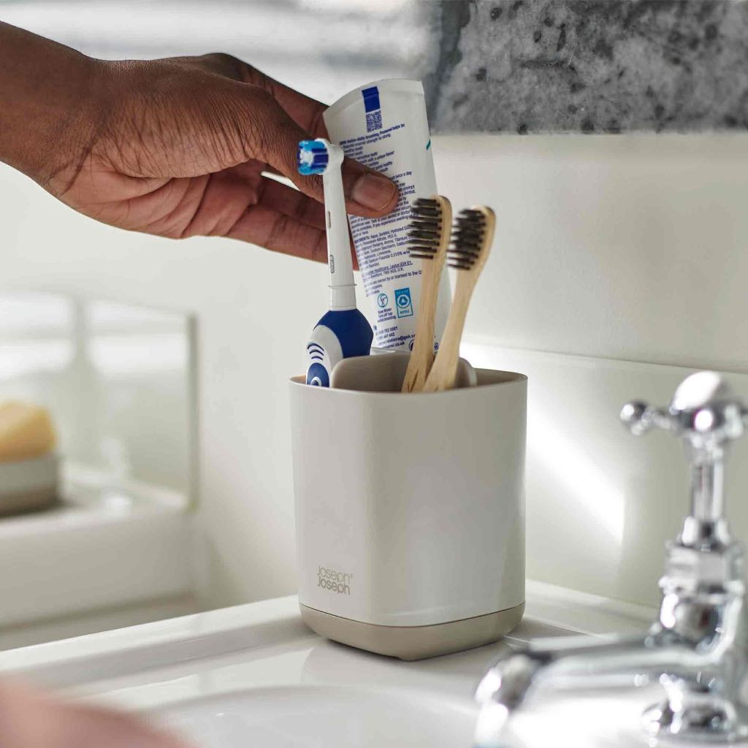

How can I remember to take my medicine?
Work out what works for you!
Keep medicines somewhere safe but sensible
Coordinate with another activity
Set alarms
Pill boxes can help you stay on track

Slide 56




What else can I do?
Medicine is very important, but there are some other things that can help:
  Hydration
  Warmth
  Relaxation
  Gentle exercise

Slide 57
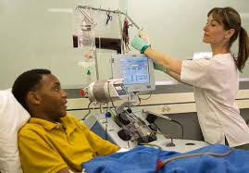
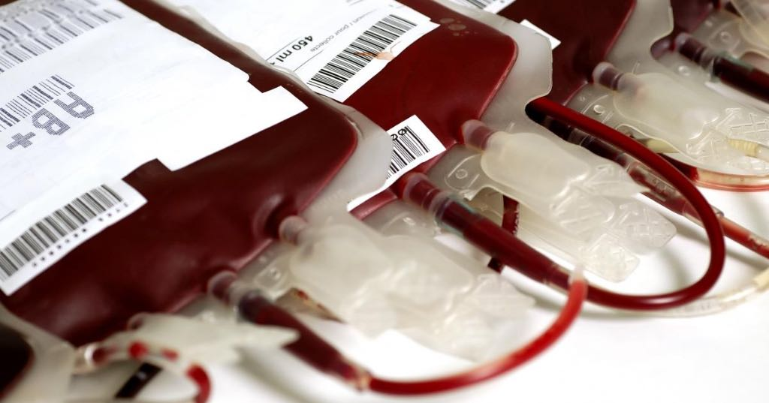
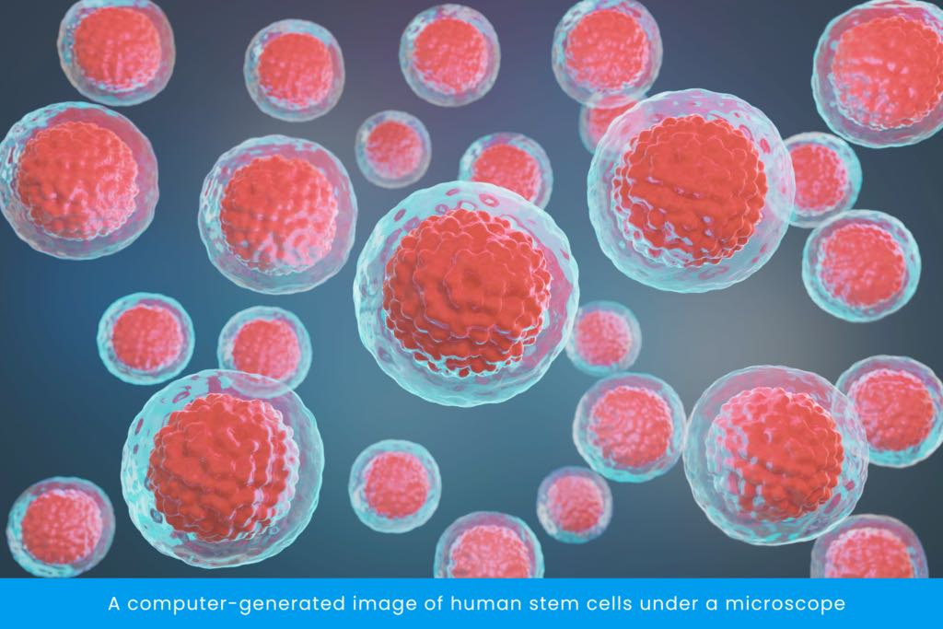
Are there any other treatments?
Red Cell Exchange
Blood Transfusions
Stem Cell Transplant/
Gene Therapy

Slide 58
Thank you

Slide 59
Cheryl Hall, Polly Crookes, Carly Bell
Haematology Nurse Specialists, Sheffield Children’s hospital
Transition

Slide 60
What is Transition and why do we do it?

Slide 61
What exactly is transition?
Transition is the process of moving your Sickle Cell Care from Your Children’s Hospital to your Adult Hospital.
The process starts at around 14yrs.But can start earlier.
You will be invited to additional Transition clinics alongside your usual appointments.

Slide 62
Why do we use the Transition Process
To prepare young people for adult services.
01
To increase your knowledge around Sickle Cell and the care you receive
02
To increase your confidence
03
To increase your independence
04
To support you in managing your health
05

Slide 63
Transition process -
The transition process happens over a long period of time.
Begins at 14yrs, generally. You can transition to your adult hospital at 16yrs but can stay with your children’s hospital until 18yrs if you feel you want/need to.
Who’s included in the process?
YOU !!!
Your parent/carer, Your current consultant, Your current specialist nurse, the consultant you will be moving to and the specialist nurse team that will be supporting you.

Slide 64
Transition is important because -
Teenagers and young adults are massive risk takers-
May not take medications at all or irregularly
May put themselves in high-risk situations
Outside influences can affect compliance with medications and self care
Brain Development isn’t complete –
Although you may think it is, your brain isn’t fully developed until about 25yrs.
Outside influences and other people’s opinions, idea’s, cultural Norms may influence how you feel about your health and how you care for yourself.
Massive time of change – Puberty, Exams, leaving home to go to university etc

Slide 65


Transition is important because -
All of these factors have a massive impact on how you feel about your health, how you treat your own health especially Your Sickle Cell health, and how you look after your health and well-being in general.

Slide 66

The aim of transition
To move from paediatrics
Parents /Carers giving and managing medicines
Parents/carers arranging appointments
Parents/carers Talking to Dr’s & Nurses
Parents/carers making all the decisions
To the adult Hospital
YOU taking medications independently
YOU knowing about your Sickle Cell and how to manage it
YOU arranging your hospital appointments
YOU talking to the Dr’s and Nurses about your care

Slide 67

Tools used to help the transition process
Transition Clinics – Generally done in your children’s hospital, Adult Consultant and Nurses attend to discuss with you how they work and what to expect.
Ready steady go – Questionnaire style papers that aim to find out your knowledge and understanding of Sickle Cell and medications.
Ask 3 Questions – 3 questions that you can ask your Dr /Nurse to help you understand any questions regarding your sickle Cell care.
Health Passport – Information regarding your health that you can use to help any new Dr’s /Nurses you meet understand how you manage your Sickle Cell.

Slide 68

Any Questions ?

