Slide 1

Sickle Cell Disorder
Patient Education Event
21st June 2025

Slide 2
Hallam Hall
Time | Topic | Presenter
10:30 - 10:40 | Welcome & Introduction | Dr Emma Astwood & Dr Clare Samuelson
10:40:11:00 | Patient Rep Group | Blessing Olasolomon and Lizzy Okokwa Chair & Deputy Chair N E & Y HCC Patient Rep Group
11:00 - 11:30 | Fertility and pregnancy | Dr Étienne Ciantar
11:30 - 11:50 | Break - Rock choir Refreshments Chef Hallam Central
11:50 - 12:30 | Nutrition | Dr Claudine Matthews
12:30 - 13:00 | New Treatments | Dr Clare Samuelson
13:00-13:10 | Group Photo
13:10 - 14:00 | Lunch - Chef Hallam Central Visit stalls
14:00-14:35 | Mindfulness | Tony Watson
14:35-15:35 | Blood donation docufilm / visit stalls | Hekima Asilia Thicker Than Water
 | Refreshments available in Hallam Hall
15:35-16:05 | Closing Keynote Speaker | John James OBE Sickle Cell Society
16:05-16:15 | Closing remarks | Dr Emma Astwood & Dr Clare Samuelson
Welcome
Notes:
Please cover
Group photo – for those happy to be in and it will be used on public platforms – head back to the steps where the choir were this morning
Food is staggered – level 10, 12:00-13:00 and main conference 13:00 / 13:10-14:00
We do have several dietary requirements today, please ensure you take from the appropriate meal selection.
Food at the end of the day staggered – coloured cards
Newcastle first
Leeds
Sheffield

Slide 3
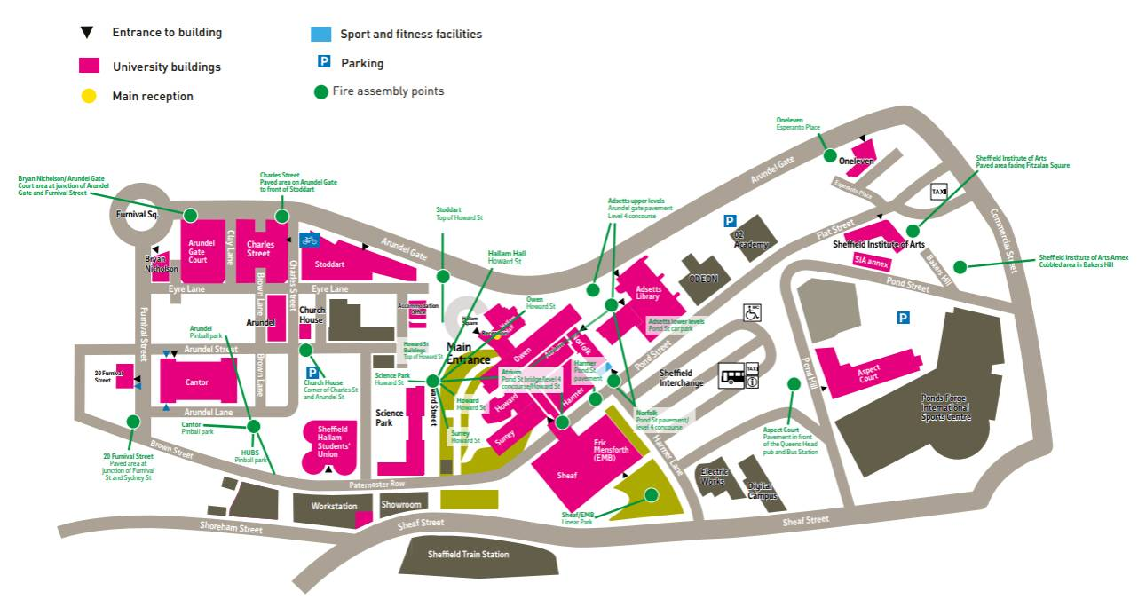
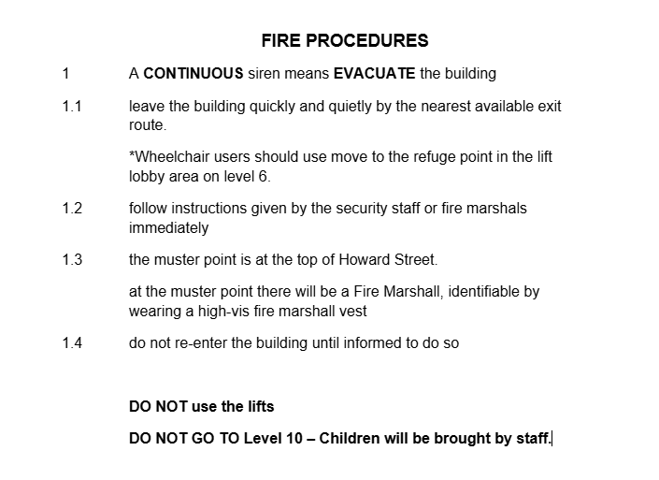
Housekeeping

Slide 4
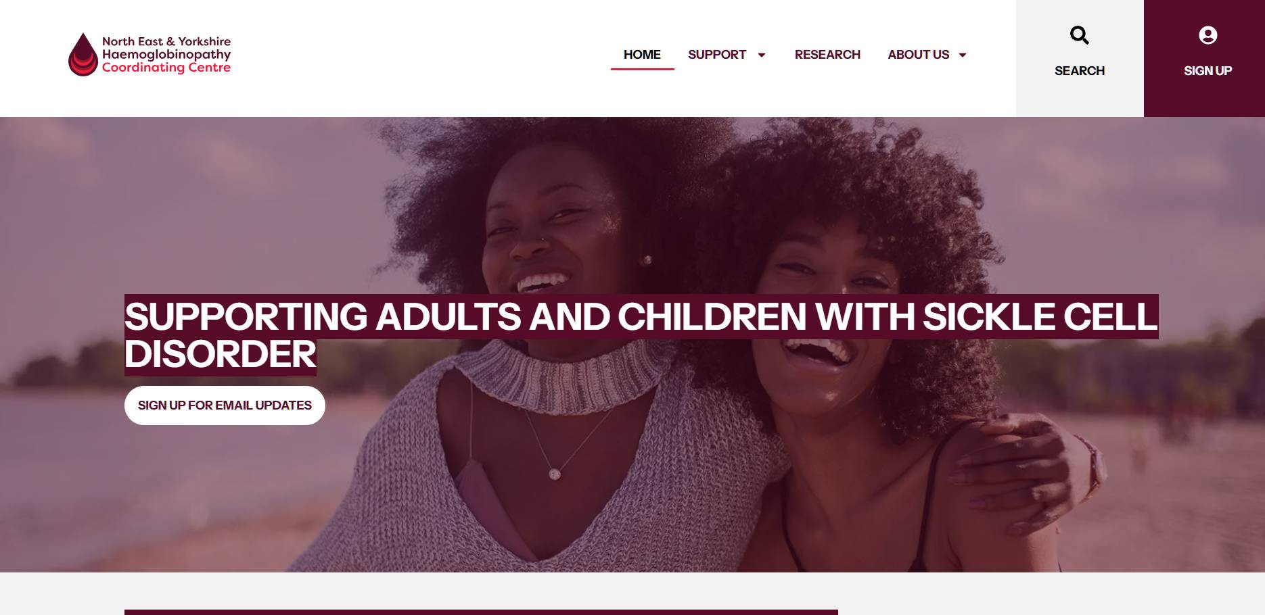
Website
Refreshed website
Photos
Speakers will reference it today
QR codes on tables
Sign Up!

Slide 5
NE&Y HCC Network Patient Representatives

Slide 6
Purpose of NE&Y HCC Network Patient Representative
The purpose of this role is to ensure that the Northeast & Yorkshire (NE&Y) Haemoglobinopathy Coordinating Centre (HCC) network actively listens to and learns from the experiences of individuals living with Sickle Cell Disorder (SCD) and their carers.
The Patient Representative Chair, Deputies, and the wider patient representative panel, with the support of the NE&Y HCC Network, facilitate regular meetings to gather feedback, share positive ideas, and provide constructive input to help shape and improve the services delivered by the network.
The group is made up of individuals with direct lived experience of Sickle Cell Disorder (SCD), whether through managing the condition personally or supporting a family member or friend affected by SCD or sickle cell trait. Our insights play a vital role in shaping patient-centered care and service improvement.
.

Slide 7
Main Duties
Develop effective methods and forums to gather the views and experiences of SCD patients and carers across the NE&Y HCC region, ensuring these insights inform the NE&Y HCC work plan.
Review SCD-related guidance regularly and evaluate its impact on patient and carer outcomes.
Identify and share best practices to promote high-quality care throughout the network.
Escalate immediate concerns or risks to the NE&Y HCC Network Manager for prompt resolution.
Provide ongoing feedback to the NE&Y HCC Business Meetings, highlighting key areas that require further attention and action. Etc..

Slide 8

Overview of the Patient and Carer Representative Team
The group consists of 28 members in total, including 1 Chair, 3 Deputies, 23 patient and carer representatives' members, and 1 multidisciplinary team (MDT) representative who also serves as the Data Manager and Engagement Coordinator. All roles within the group are undertaken on a voluntary basis

Slide 9
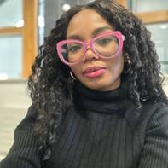
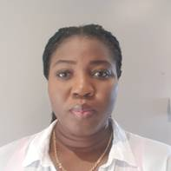

Patient Representatives
Chair: Blessing Olasolomon is a global student recruitment strategist and a passionate advocate for Sickle Cell Warriors. With an MSc in Advertising and Marketing, she blends educational expertise with lived experience to create meaningful impact. As Chair of the NE&Y HCC Patient Voice, Blessing is committed to empowering underrepresented voices, and championing health equity worldwide.
Dept. Chair: Elizabeth Okokwa, is an expert with extensive experience in global healthcare initiatives. Elizabeth has collaborated with international medical organizations focusing on disease prevention and community healthcare. Now a Charity Administrator in Yorkshire, Elizabeth’s expertise, experience and her personal journey with her young daughter, a resilient sickle cell warrior, drive her dedication to advancing sickle cell care and advocating for equitable health solutions.
:
Dept Chair: Christobel Iwoba, is a dedicated Healthcare Assistant and Support Worker committed to sickle cell advocacy and patient well-being. She aims to become a haematology or mental health nurse, driven by a purposeful approach to life and work.
Dept. Chair: Johnson Ochai, is a Solicitor with Liberty Solicitors. He brings a strong legal and advocacy background to his role as Deputy Chair for Patient Representation at NE&Y HCC. His focus is on ensuring that every voice within the sickle cell community is valued.

Slide 10
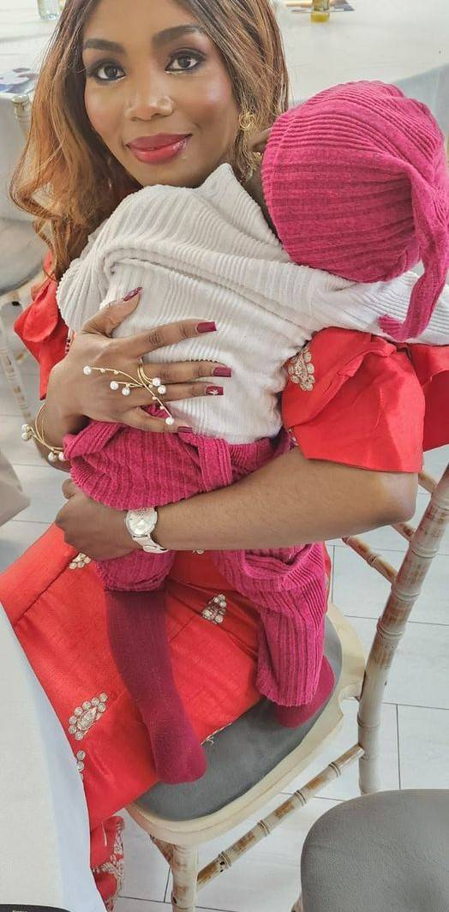
Blessing’s background and motivation
Diagnosed with Sickle Cell Anaemia at age 7 in Nigeria, my journey has been marked by resilience and hope. Since moving to the UK in 2022, I have faced numerous challenges , from chronic crisis pain and multiple ICU stays to chronic leg ulcers and a traumatic pregnancy in 2023.
Managing sickle cell is not just about surviving , it’s about living fully, with dignity, support, and a powerful voice. That’s why I joined and serve as Chair of the Patient Public Voice. No one living with sickle cell should ever feel invisible.
For me, representation isn’t just important, it’s life-changing.
:
In 2025, I experienced a stroke scare, a moment of profound fear not just for myself, but for my daughter. Today, I undergo monthly red cell exchange transfusions to reduce that risk. It’s exhausting, but it fuels my determination.

Slide 11

Christobel’s background and motivation
Daughter, sister, friend, Healthcare Support Worker, and Deputy Chair for Patient Representation at NE&Y HCC.
Diagnosed with sickle cell anemia at birth, I’ve faced chronic pain, multiple hospital stays, blood transfusions, and thigh ulcers. A portacath helps ease treatment challenges. Living with sickle cell is a constant physical, mental and emotional battle, often made harder by not being believed.
I’m committed to advocating for compassionate, patient-centered care. Through my lived experience, I strive to ensure everyone with a haemoglobin disorder is heard, respected, and valued ,in the Northeast & Yorkshire and beyond
:

Slide 12

Lizzy’s background and motivation
I’m a mother to a vibrant, courageous young daughter living with Sickle Cell Disorder. She was diagnosed at the age of 3 years, and since then, the journey has been both challenging and transformative.
Balancing full-time work, caring for three other children, and managing the many demands of daily life can be overwhelming , but her care and well-being remain my absolute priority.
Like many parents and carers, I often find myself stretched thin , emotionally, physically, and mentally. But I show up every day because my daughter deserves not just to survive, but to thrive. She deserves a future filled with opportunity, dignity, and compassionate care.
:
I joined the Patient Public Voice group because representation matters. Every family affected by sickle cell deserves to be heard and to help shape the care they receive. I’m here to be that voice, not just for my daughter, but for every family on this journey.

Slide 13
Johnson’s background and motivation
Lived with sickle cell all my life, my motivation isn’t to retell what many already know, it’s to help build better systems, stronger patient engagement, and a culture of listening within healthcare.
This role gives me the opportunity to represent the interests of patients across the region, inspire confidence in others living with haemoglobin disorders, and contribute to positive, patient-led change. My focus is on collaboration, compassion, and making sure that lived experience is valued as expertise in its own right.

Slide 14
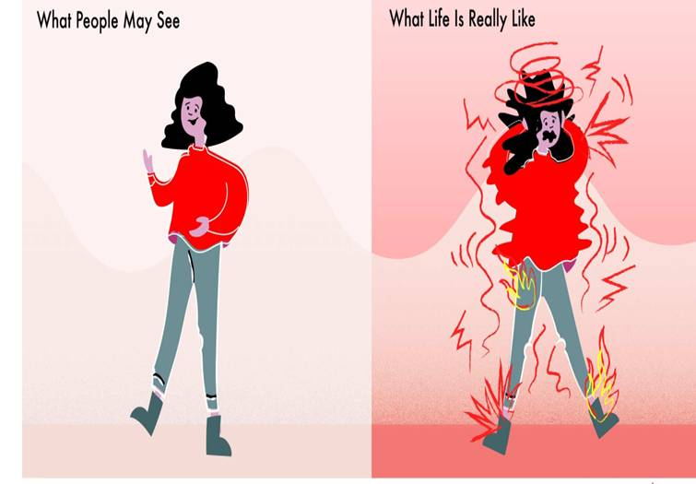
NE&Y HCC (PPV)– Our Impact and Actions
As Patient Public Voice (PPV) representatives, we are actively involved in shaping better care for the sickle cell community. So far, we’ve had the privilege to:
Contributed practical ideas for Winter Care Packs to support Sickle Cell patients in the NE&Y region.
Helped shape better patient communications, including contributing to the development of a new, more accessible website.
Shared lived experiences at NHS patient education events to promote better understanding and patient-centered care.
:

Slide 15

NE&Y HCC –Involvement so far
Present at NHS Staff Education Days, bringing the patient voice directly to healthcare professionals
Raise important concerns about emergency care, chronic leg ulcers, and the ongoing stigma around pain.
We engage. We speak up. We improve- together.
And we’re just getting started.
Stay connected:
🌐 www.ney-hcc.co.uk/patient-engagement
:

Slide 16

Why Your Voice Matters
Medical expertise saves lives , but lived experience transforms care.
As patients and carers, we know what it feels like:
The unbearable pain of a crisis that words can’t describe.
Navigating endless A&E visits, trying to explain fatigue that never truly goes away.
Facing stigma, isolation, mental health struggles, and strained relationships.
Missing out on life simply because hospital visits become the norm.
But your voice can change that.
When we show up, speak up, and share our experiences, systems listen, and care improves.
:

Slide 17

Ready to be a part of Positive Change?
Your Voice Matters - Join Us
We need more voices. More stories. More strength. Whether you’re living with sickle cell, a parent, or a carer, your experience can help drive change.
Be part of the movement.
“Together, we can shape a better, fairer future for everyone affected by sickle cell”
Join us today:
https://www.ney-hcc.co.uk/patient-public-voice-group-ppv-application-form/
Real voices. Real change.
:

Slide 18

:

Slide 19
Dr Étienne Ciantar MD, FRCOG, FHEA
Consultant – Obstetrics, Obstetric Haematology & Medical Education
Leeds Teaching Hospitals NHS Trust
Fertility and Pregnancy

Slide 20
PATIENTS AND HOSPITALS
“for sickle cell patients, positive experiences of hospital care are the exception”
    mistrust
    control
    stigmatisation
    neglect

Slide 21
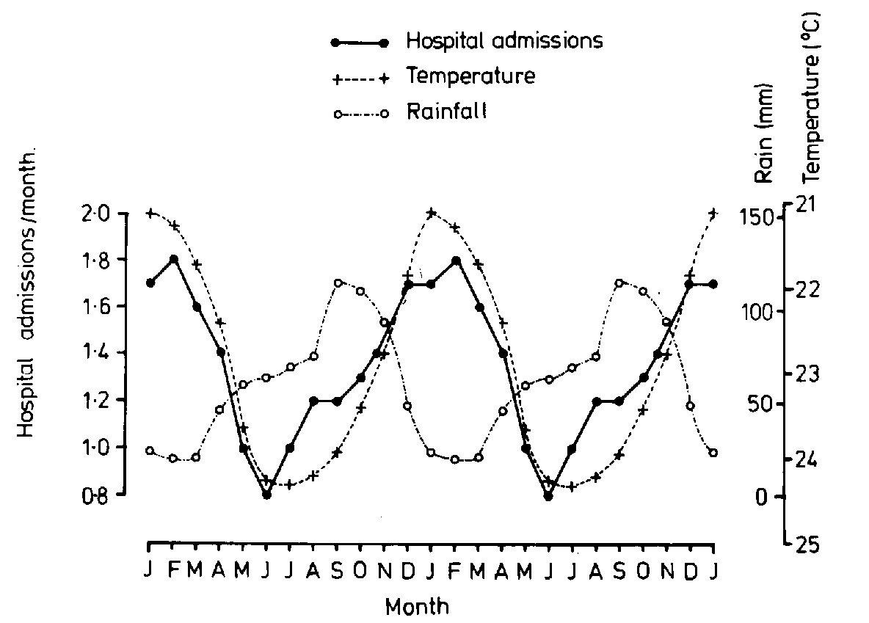
Precipitants of Sickle Cell Pain
Dehydration
Infection
Climatic
Psychological
Pregnancy

Slide 22

High risk situations
Any patient with painful crisis
Post operative
  abdominal surgery
Pregnancy
  final trimester & post-partum

Slide 23



Slide 24

Obstetrics
Haematology
Specialist Midwife
Specialist Nurse
Anaesthetist
Neonatology
Blood Bank

Slide 25
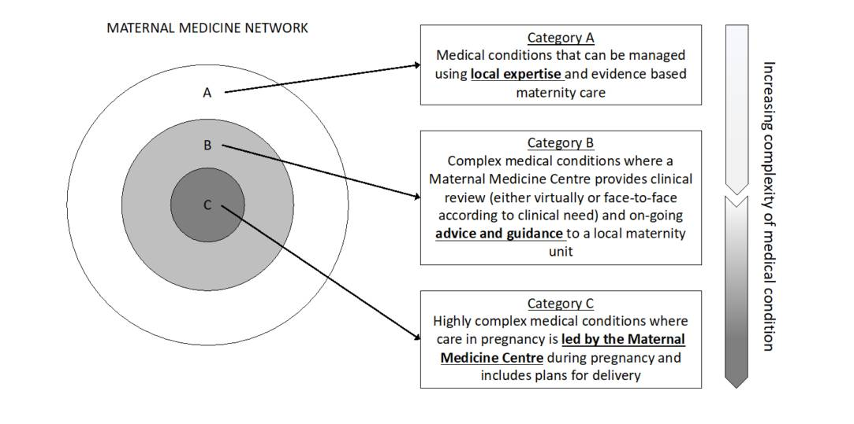
Maternal Medicine Network

Slide 26
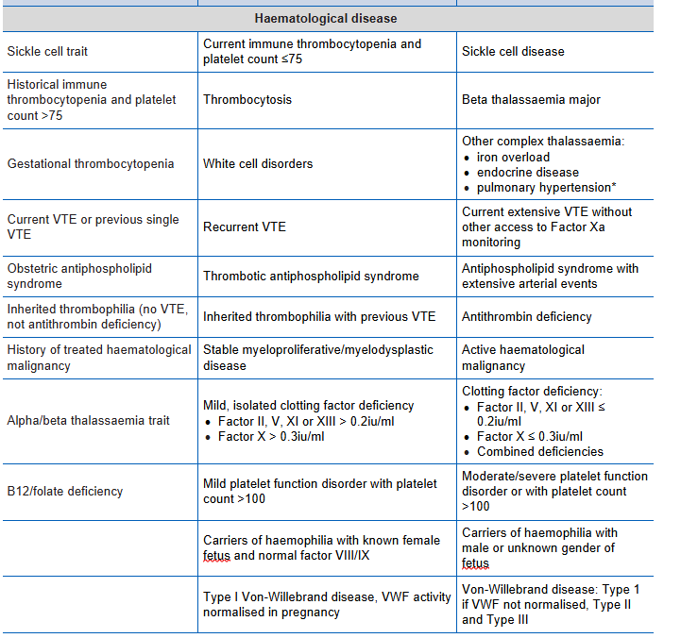

Slide 27
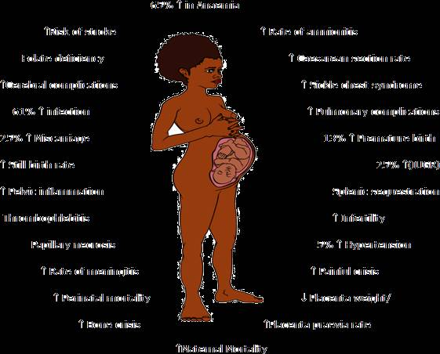
Sickle cell and pregnancy

Slide 28
Maternal morbidity
Increased risk of
  Hypertension and pre-eclampsia
  Acute painful crisis: 20-56%
  Anaemia
  Infections (especially UTI: 16-23%)
  Acute chest syndrome (11-17%)
  VTE (Increase in DVT not PE – US cohort)
  Caesarean section: 30-62%

Slide 29
Increased maternal mortality
Range from 0% to 9.2% in studies of centres across the world
  UK national data: approx. 1 death per year
    UKOSS study 2010-2011 no deaths in 108 pregnancies
    However, 3 reported deaths in 2016
  US Co-operative study (1980’s, 1990’s)
    0.4% mortality
  US In-patient sample 2000-2003
    72.4 deaths per 100,000 in SCD (0.07%)
    12.7 deaths per 100,000 in all pregnancies(0.01%)

Slide 30
Fetal complications
 | Perinatal mortality | Fetal growth restriction | Prematurity
Ngo: SS | 2.1% | 14% | 16%
Yu | 1.4% | 18% | 24%
Chase | 2.4% | 20% | 19%
UKOSS | 2.7% | - | -

Slide 31
HbSS vs HbSC
HbSC tend to have milder phenotype
  Jamaica (95 pregnancies)
    No difference in pre-eclampsia, stillbirth rate, mean birthweight from AA controls
    Sickle related complications similar to SS
  France (33 pregnancies)
    No difference in obstetric outcomes and perinatal outcomes from AA
    Pain in 36% (cf 42% of SS)
Decreased risk of maternal and fetal complications in HbSC
BUT
Although most are mildly affected, some do have serious complications
Not possible to predict who will have severe complications
Therefore treat in same way as HbSS

Slide 32
Can intervention improve outcome?
Benin, West Africa
June 1993-Dec 1993
  15 pregnancies
  4 maternal and fetal deaths/2 fetal deaths (27%/40%)
Feb 1994 – Dec 1997. Prospective study
  Education, nutrition, malaria prophylaxis and antibiotics
  108 pregnancies
  2 maternal deaths (1.8%), 13 fetal deaths (11.9%)
Rahimy et al 2000
Notes:
There is one prospective observational study from Benin
This was prompted by observational data in 1993 looking at 15 pregnancies with a very high maternal and fetal death rate. From Feb 1994 they introduced an educational and supportive package which included educational advice about SCD, info on nutrition, treatment with malaria prophylaxis and early identification and treatment of infection. They collected data on 108 pregancies over the next 4 years – maternal mortality was only 1.8% which compared favourably with overall maternal mortality rate in the hospital of 1.2%
Fetal loss rate of 11.9% - still high when compared with hospital rate of 6.3%
Low cost interventions – widely applicable

Slide 33
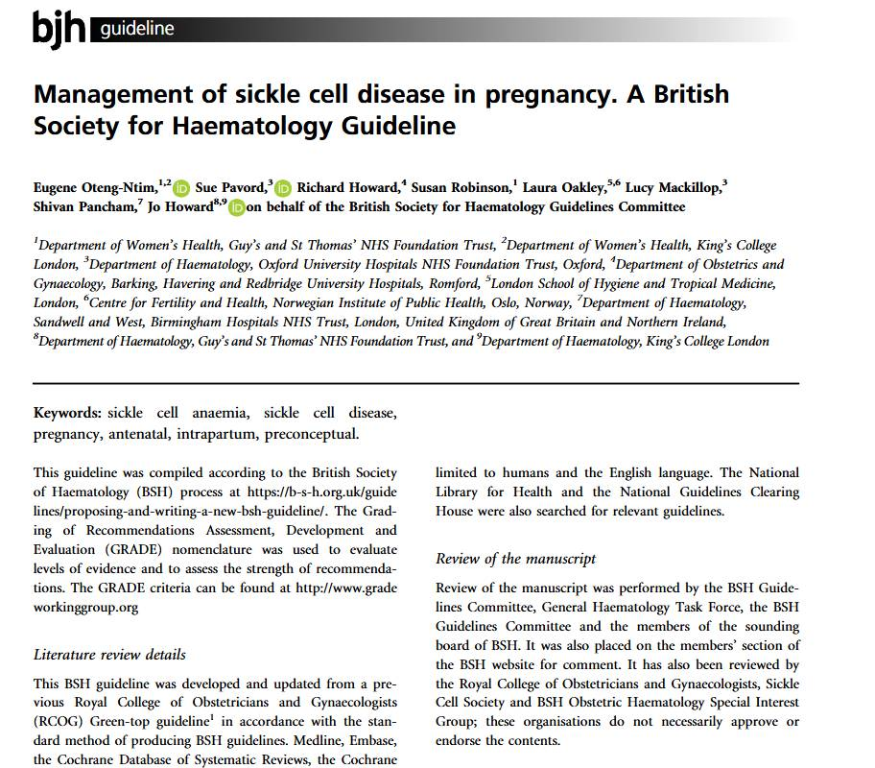

Slide 34
SCD and pregnancy
Pre-conception
Counselling +/- partner testing
Contraceptive advice
1st choice: progesterone only (pill, depot, implant)
2nd choice: copper IUD, combined pill
Fertility – sperm count/mobility, impotence
Medications – hydroxycarbamide, ACE inhibitors
Screen for red cell allo-antibodies & iron overload (if transfused), review vaccination status, record full red cell phenotype, consider ECHO if not done in last year.

Slide 35
Pregnancy complications
Maternal
Increased incidence of:
Infection (UTI, pneumonia, puerperal sepsis)
Painful crisis
Acute chest syndrome (Fever, tachypnoea, pleuritic chest pain)
Venous thromboembolism
Preterm labour
Pre-eclampsia
Caesarean section
Maternal death (0-9%, UKOSS 0%)
Fetal
Increased incidence of:
Miscarriage
Intra-uterine growth restriction
Prematurity
Fetal distress
Stillbirth/neonatal death (perinatal mortality 15% ie: 15x general population)

Slide 36
Antenatal review
Clinic schedule in a specialised tertiary unit setting
  4 weekly to 24 weeks
  2 weekly to 38 weeks (alternating midwife and obstetric team)
  Then weekly
Ensure on folic acid 5mg and penicillin prophylaxis
LMWH blood thinning injections from 28 weeks or before
Aspirin 150mg from 12 to 36 weeks
Oral iron if lab evidence of deficiency

Slide 37
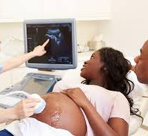
Antenatal monitoring
Ultrasound:
  Early viability scan at 7-9 weeks gestation
  Routine first-trimester dating scan at 11-14 weeks +/- Downs screening
  Anatomy scan at 20 weeks
  Four weekly scans for fetal growth, liquor volume and placental function from 24 weeks

Slide 38
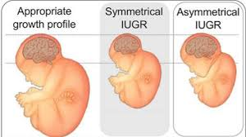

Slide 39
Antenatal monitoring
Check
Check FBC and MSU monthly (blood pressure and urine dipstick at each visit)
Discuss
Discuss suitable positions for delivery if patient with a hip replacement
Notify
Notify neonatologist in writing if neonatal complications expected
Consider
Consider induction of labour at 38-40 weeks

Slide 40
Blood transfusion
Prophylactic blood transfusion remains controversial
TAPS-2 study – serial prophylactic EBT may lead to less VOC, preterm labour and improved baby birth weight
Possible indications:
- Recurrent crisis, Hb <70g/l, previous poor obstetric history, patients on hydroxycarbamide pre-conception, multiple pregnancy
- HbSS more likely to require transfusion
- All transfusions should be discussed with the haematology team
- Transfused blood should be matched for Rh, Kell and be Hb S and CMV negative.

Slide 41
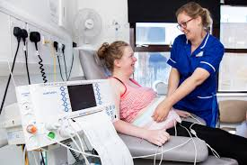
Labour and delivery
Prolonged labour (>12 hours) should be avoided, with early recourse to caesarean section as increased stress may trigger a crisis
If painful crisis occurs, give morphine
Continuous CTG
Choice of analgesia: patient's choice, but to minimise distress, have a low threshold for epidural
PCAS may be considered
Advise neonatologist of delivery

Slide 42
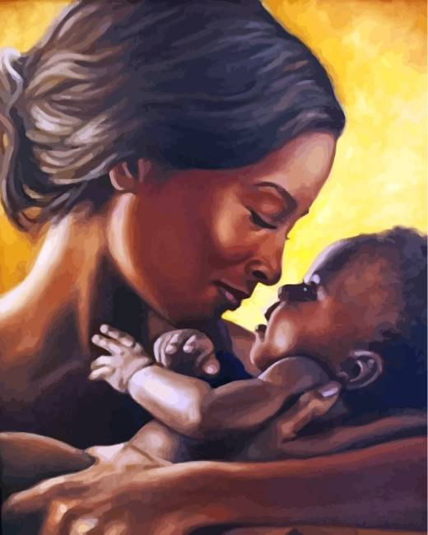
Postnatal care
Keep warm and well hydrated
Chest X-ray if any chest pain or low saturation, because of risk of sickle chest
Manage any infections quickly
Good pain control (e.g. morphine, PCA)
Anticipate the need for laxatives and anti-emetics
LMWH blood thinning injections for 6 weeks
Ensure good follow up (community midwife and haematology clinic)

Slide 43

Conclusions
SCD is a high-risk condition in pregnancy
Care needs to be provided in a specialist centre
MDT approach
Guideline driven care but with an individual patient-centred approach
300 babies are born each year in the UK from SCD mothers

Slide 44

Your Diet Your Health:
Healthy Eating Principles to improve Your Health Outcomes
Presented by
Dr Claudine Matthews DPROF HSC RD FHEA
NE & Y Patient Education Event
21st June 2025

Slide 45

Education Session (1) Agenda:
Part 1: How sickle cell affects your nutrition
Part 2: Why is good nutrition important
Part 3: Improving your nutritional intake using the Sickle Cell Nutrition Eatwell guide
Part 4: Benefit of Good nutrition

Slide 46


My Background
South Africa
Apartheid – experienced racism, marginalisation and disempowerment
Worldview of social justice, advocacy and empowerment
Moved to the UK in 2000
Introduced to sickle cell in 2011 and sickle cell nutrition in 2014
Started my doctorate in 2016 and completed in 2023
Founded – Sickle Cell Nutrition Academy in 2023
Consultant Dietitian –
  Leading education and guidance, advising on complex nutritional problems, research and innovation - advancing sickle cell nutrition

Slide 47
Part 1: How sickle cell affects your nutrition

Slide 48
Rationale for Sickle Cell Nutrition?
Cause
  Ongoing break down of your red blood cells
  Sickle cell crisis causes tissue and organ damage
  Increased risk of infection
Impact
  Chronic anaemia/fatigue
  Multiple Nutrient deficiencies
  Poor nutritional
  Impaired immunity
Management
  Eating a Healthy Balanced Diet
  Engage in healthy lifestyle activities like regular activity
  Don’t smoke, reduce alcohol intake

Slide 49
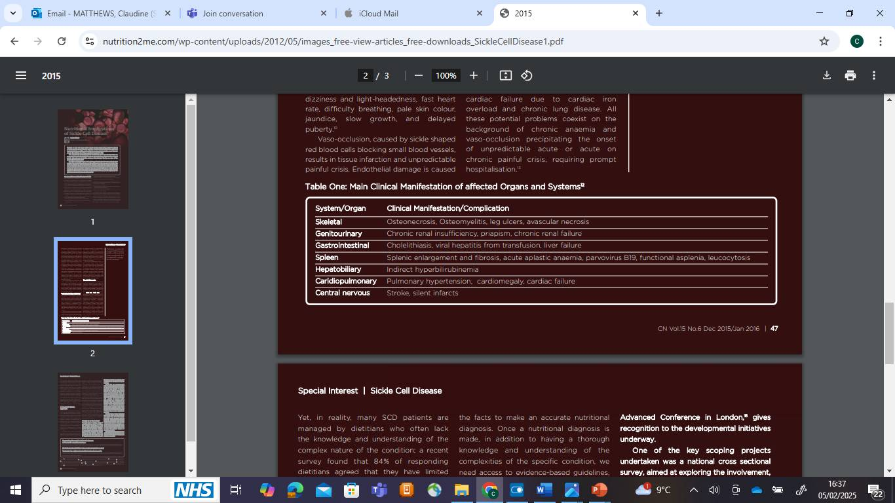
Your sickle cell complications can affect your Nutritional Needs

Slide 50
Common Nutritional Problems
Common Nutritional Problems
1.Malnutrition
2.Aneamia/Fatigue
3.Impaired Immunity/Chronic Inflammation
4.Dehydration/ Constipation
5.Iron Overload
6.Osteoporosis
7.Increased risk of cardiovascular disease

Slide 51
Part 2: Why is good nutrition important?

Slide 52
Why is good nutrition important?
Building a good Nutritional Status and preventing malnutrition:
1.Eating a balanced diet:
Eat the right types of food
Eat right amount of food
Eat the right variety of food
2.Choose food from all the food groups:
Ensure the right balance of nutrients to meet your bodies needs
3. Help your body to function as Optimally as possible
4. Enjoy a good quality of LIFE and do the things that you Enjoy doing.

Slide 53
What is needed for a good nutritional Status
Healthy Balanced Diet
Anthropometry:
(size, proportion and body composition)
Weight
Height
Body Mass Index (BMI)
Weight loss
Weight gain
Inflammation
How sickle cell affects your health

Slide 54



Healthy Life Expectancy
Blue zone principles (Dan Buettner)
9 principles:
1st…Move naturally
2nd…Have a purpose
3rd …Downshift
Find out the other 6 and tell me to win a surprise prize…

Slide 55
Part 3: Improving your nutritional intake using The Sickle Cell Nutrition Eatwell Guide

Slide 56
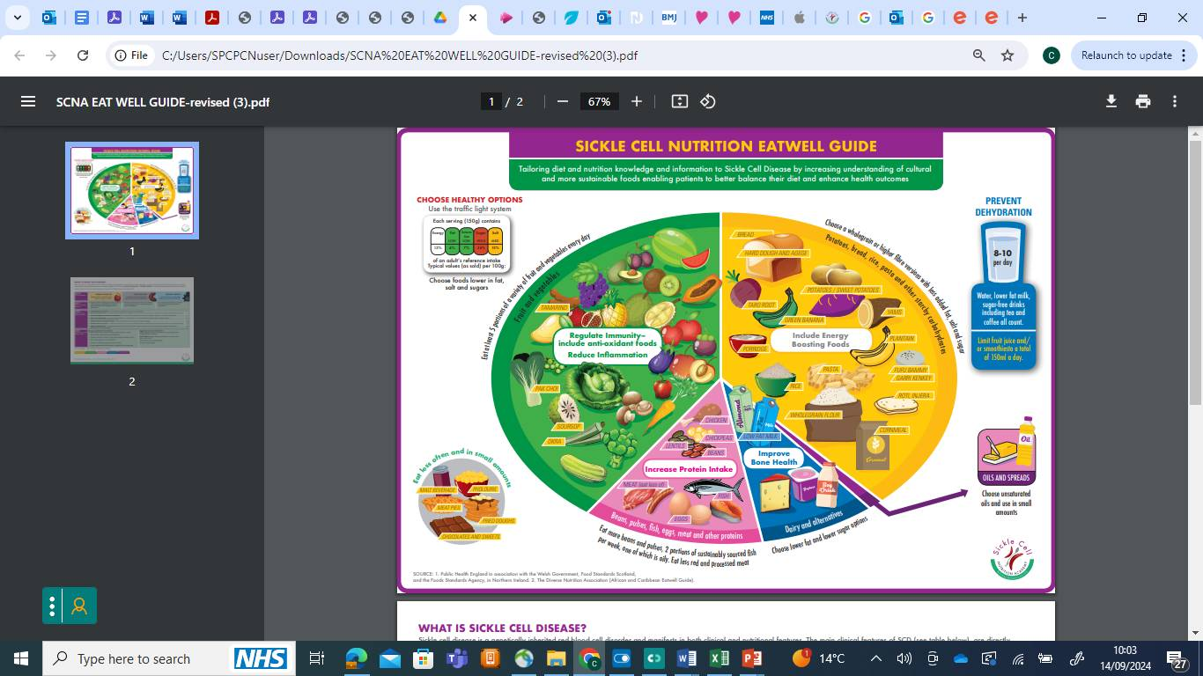

Slide 57
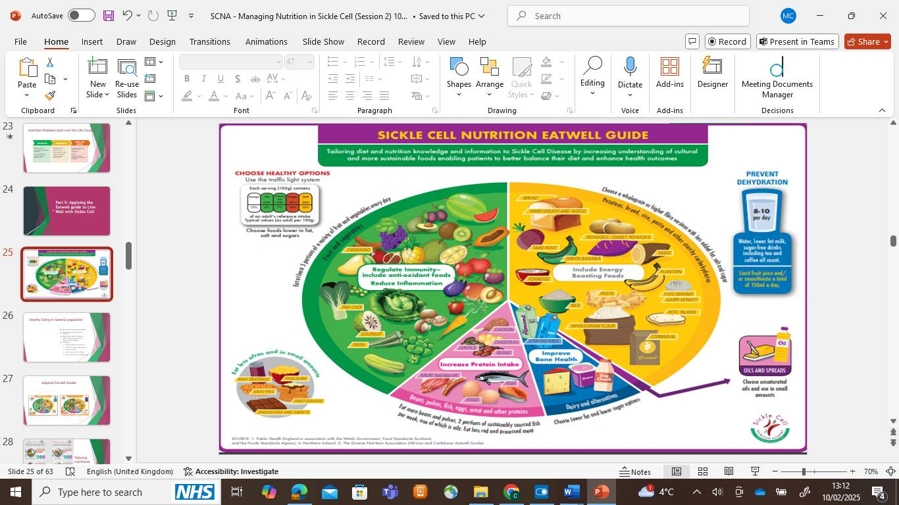
7 Key Healthy Messages in the SCD Eatwell Guide
1. Include energy boosting foods
2. Increase protein intake
3. Regulate immunity -include antioxidant foods
4. Reduce Inflammation
5. Improve bone health
6. Prevent Dehydration
7. Choose Healthy options

Slide 58
5 Food Groups
Carbohydrates (CHO)- breads, cereals, potatoes, rice, pasta, yam, plantain
Fruit and Vegetables (Your 5 a Day)
Proteins - Beans, pulses, meats and other protein, fish, eggs, other proteins
Dairy, milk and milk alternatives, cheese, yogurt
Fats and oils

Slide 59
Nutrient Deficiencies
Macro Nutrients:
Energy – (factor in disease related factors)
Protein
Fluid (increased requirements)
Micronutrients:
Zn, Se, Vit D, A, C, E, B vitamins, folic acid
Iron – (absence of iron overload)
Omega 3 Fatty acids

Slide 60


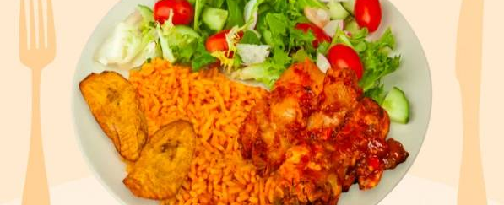

Healthy Balanced Meal Examples
Used with permission and taken from the Carbs & Cals app.

Slide 61
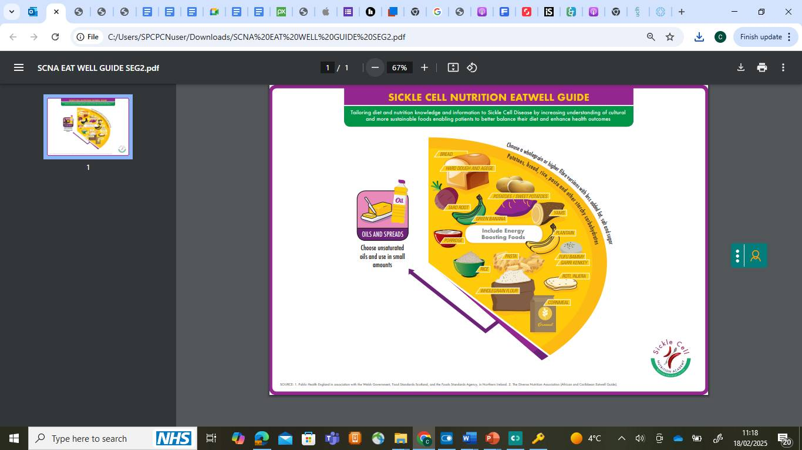
Provide energy, carry fat and help absorb fat soluble vitamins
Best source of energy, fibre, B-vitamins
Fats and Oils
Starchy carbohydrates and
wholegrains

Slide 62
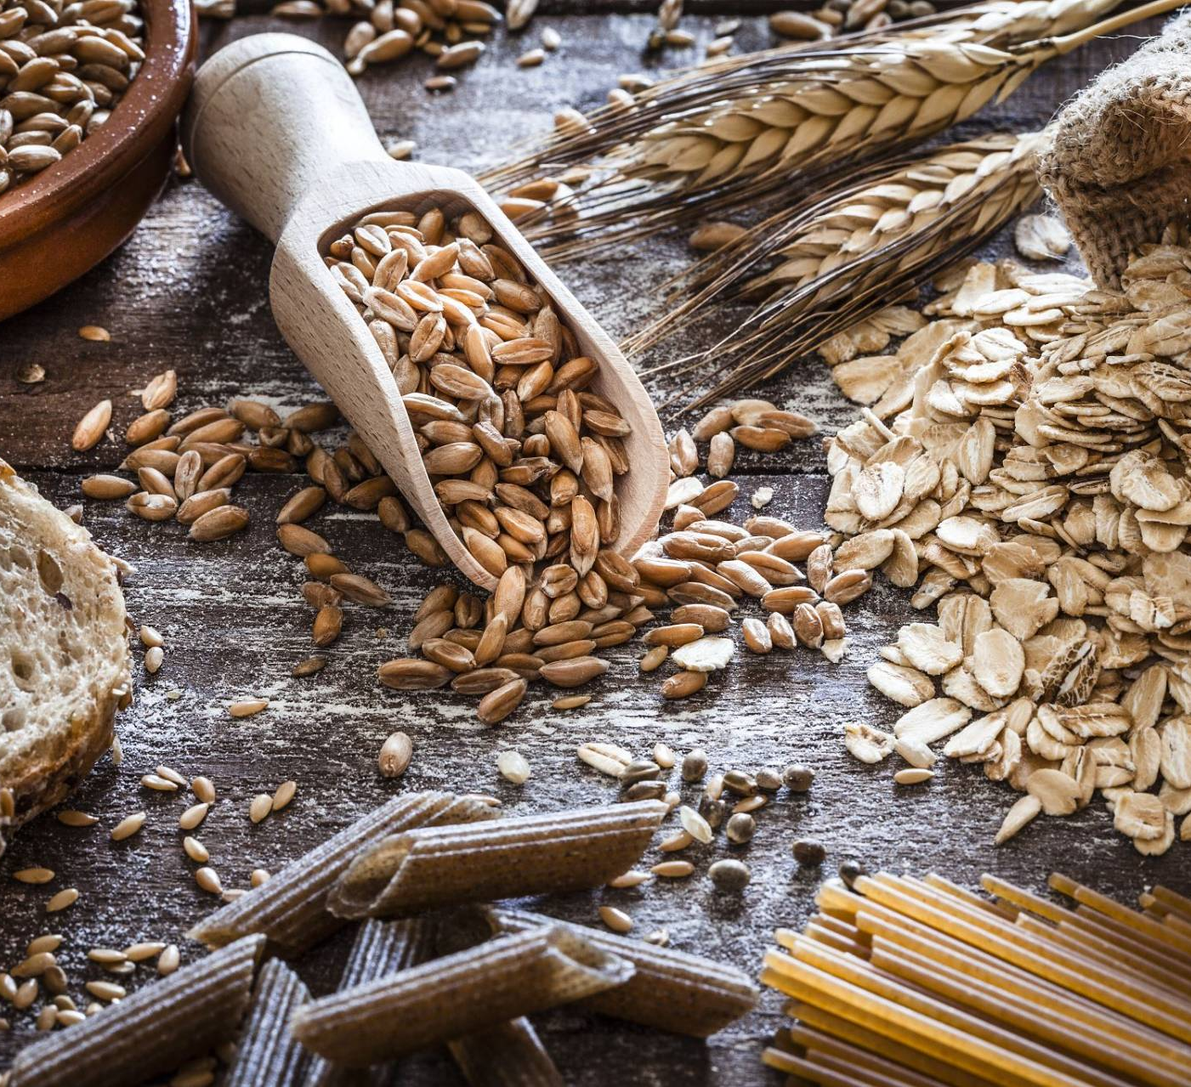



Choose wholegrain carbohydrates!
Good source of fibre to help reduce and prevent constipation

Slide 63
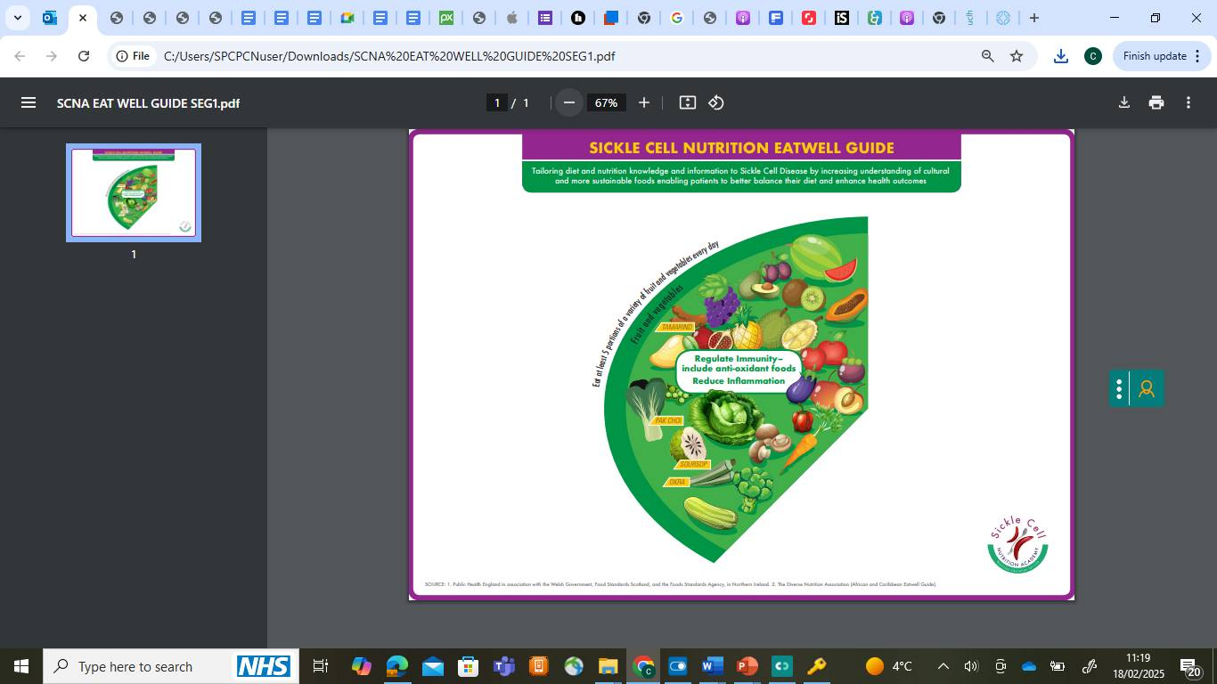
Provides vitamins and minerals, fibre and anti-oxidant rich foods
Fruit and Vegetables – 5 A Day
Vitamin A:dark green veg, yellow-orange veg, tomatoes, watermelon, apricots, peaches
Vitamin C:broccoli, green leafy veg, peppers, citrus fruits, berries, cantaloupe, strawberries
Vitamin E: Avocado and Vegetables, mangoes, spinach, red bell peppers, vegetables oils)

Slide 64




Choose a variety of fruit and veg – Remember your 5 A day!

Slide 65
Folic Acid – Food Sources
How can you increase my daily folic acid intake?
green leafy veg like spinach, kale, cabbage, spring greens, and broccoli
cruciferous vegetables like brussels sprouts and asparagus
beans and peas like chickpeas, kidney beans, black-eyes peas and lentils
citrus fruit, oranges and other citrus foods
tropical fruits like papaya and bananas,
fortified foods like breakfast cereals, breads, flours, cornmeal, pasta, rice, other grain products
other foods like liver, eggs, dairy products, meat, poultry, shellfish, nuts, yeast beef extract, avocado and wholewheat

Slide 66
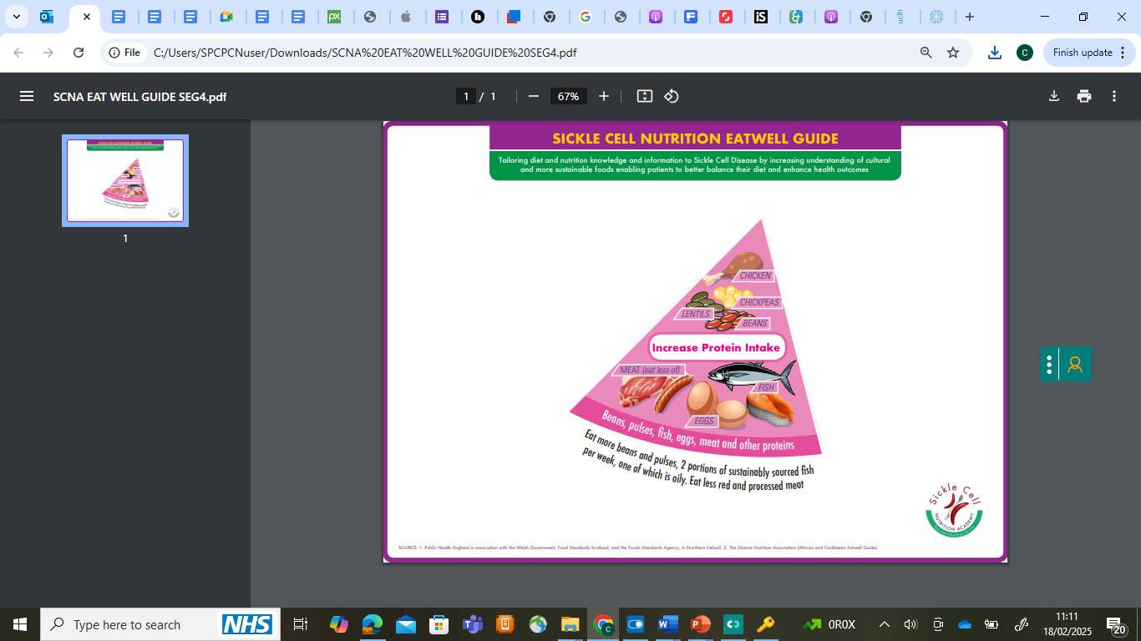
Important for growth and development, good health and vitality:
Part of all tissues
‘Protein sparing’
Protein and Plant Alternatives

Slide 67



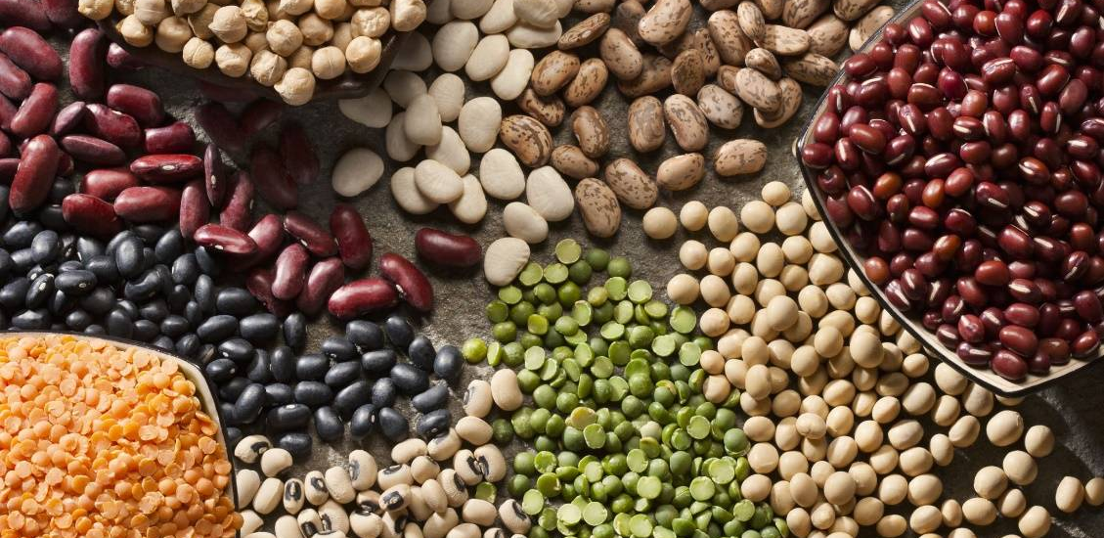
Protein sources -

Slide 68

Soya protein
Tofu
Tempeh nuts and seeds

Slide 69
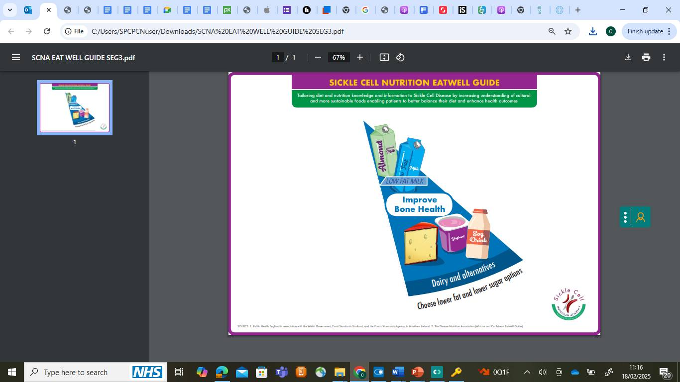
Provides calcium and a good source of protein
Dairy and Alternatives

Slide 70



Provide calcium and protein

Slide 71
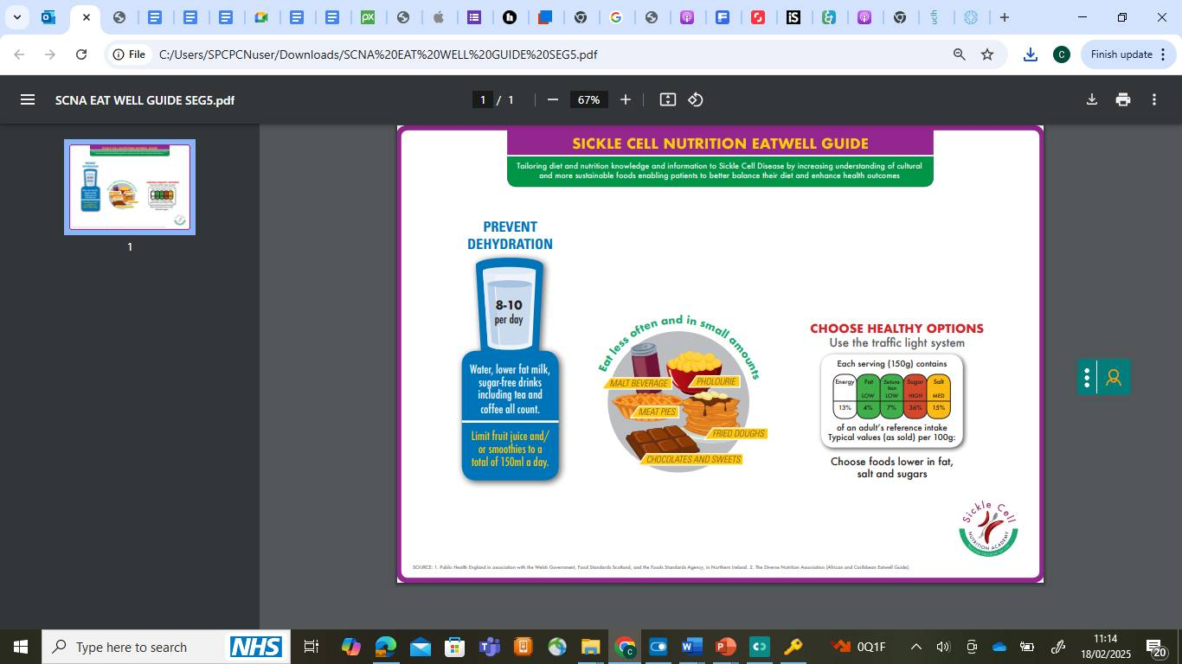
Additional Health Principles
Essential for all the bodies processes
Make healthy dietary choices to maintain a healthy weight

Slide 72

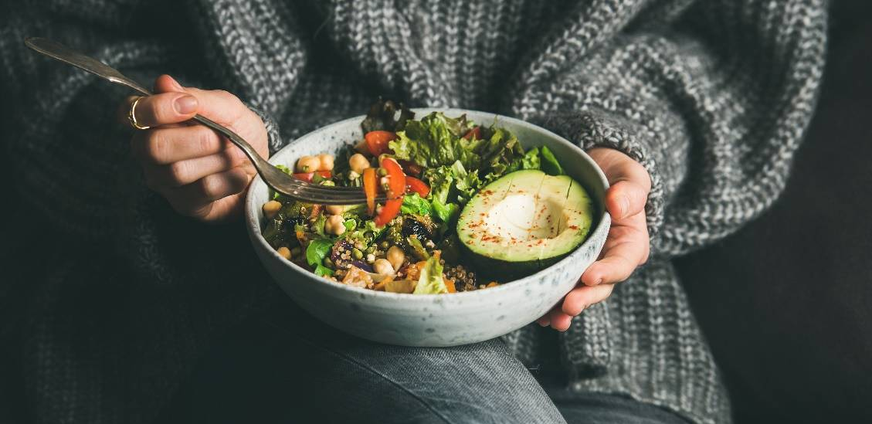
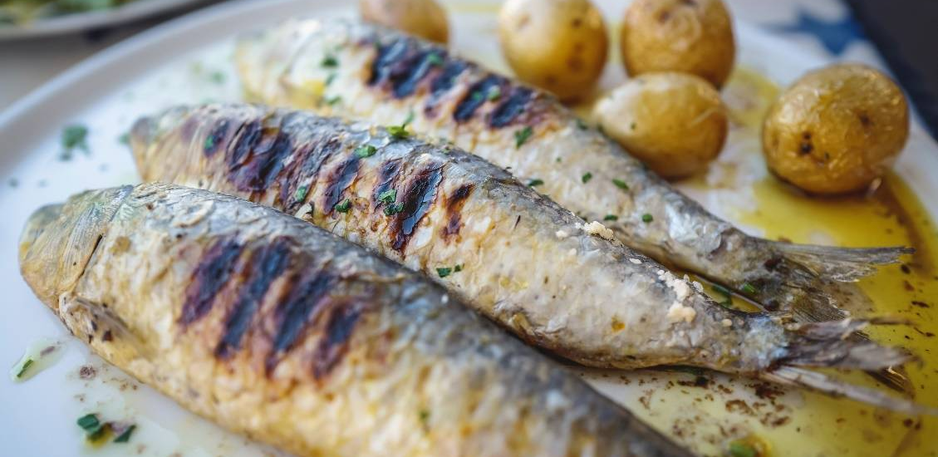

Healthy Fats – avocado, nuts and seeds, omega 3 fatty acids

Slide 73

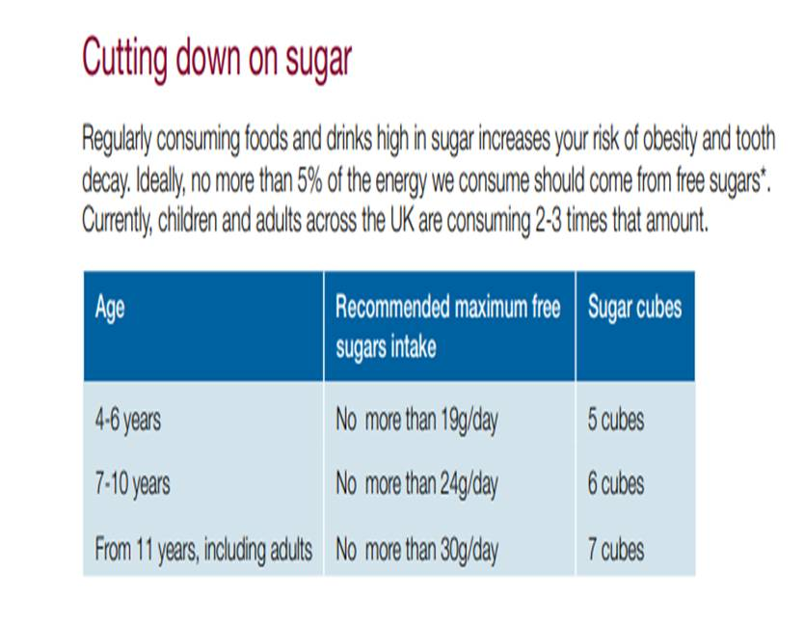

Slide 74
Part 4: Benefit of good nutrition

Slide 75

Benefits Of Good Nutrition!
Improve your Nutritional Status by eating a Good balanced Diet to,
  Help you stay healthy for longer
  Help your medication work better
  Potentially improve the morbidity linked to SCD
  Potentially reduce the impact of the side effects of medical treatment
  Potentially reduce the frequency and intensity of a crisis
  Help reduce length of stay in hospital
  Help to increase recovery rates
  Reduce the amount of medication to manage SCD

Slide 76
One thing you will Take Away…

Slide 77


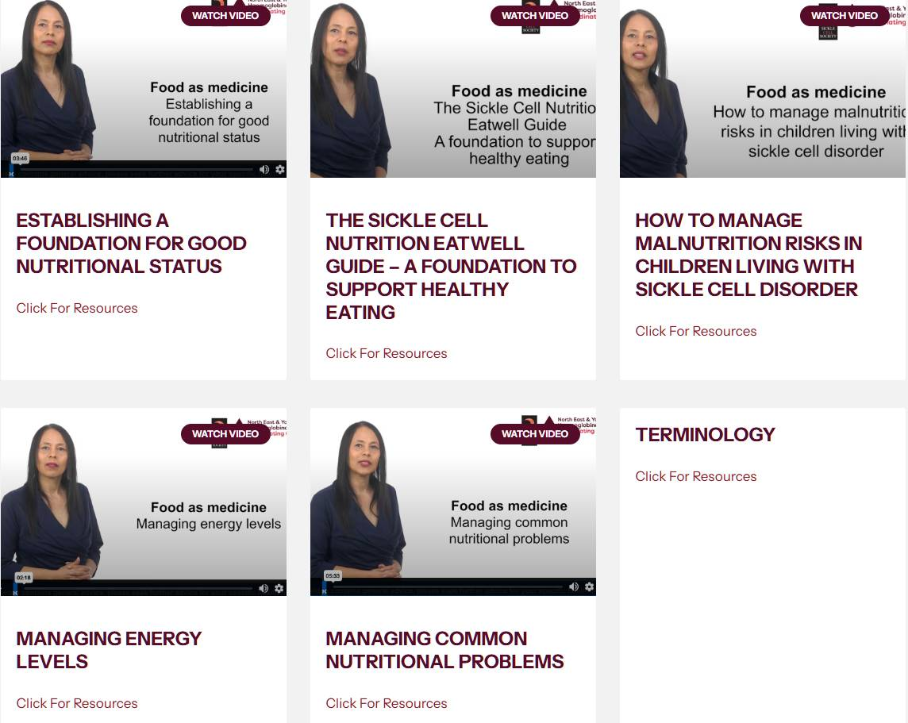
Videos
Collaboration with NE & Y HCC and Sickle Cell Society:
https://www.ney-hcc.co.uk/resources/
:

Slide 78

Thank You!
“Every closed door brings you closer to your Destiny”
Dr Claudine Matthews

Slide 79
New Treatments in
Sickle Cell Disorder
Dr Clare Samuelson

Slide 80
Outline of Talk
Why do we need new treatments?
Bone marrow transplant
Gene therapy
Clinical trials
Discussion and questions
Notes:
Image is screen shot from the NE& Y HCC website, update to include. IBHO also open at SHT and now opened FLORAL trial.

Slide 81
Why Do We Need New Treatments?
Hydroxycarbamide is a good treatment for most people
Some need regular transfusions
But…. many they still experience pain and other problems
Some people can’t receive these treatments
Limited options for alternative treatments
Notes:
Image is screen shot from the NE& Y HCC website, update to include. IBHO also open at SHT and now opened FLORAL trial.

Slide 82
Bone Marrow Transplant
What is it and who is it for?

Slide 83
Bone Marrow Transplant
Also called:
Haematopoietic stem cell transplant
Stem cell transplant
BMT
HSCT
New for adults (since 2019)
Notes:
Image is screen shot from the NE& Y HCC website, update to include. IBHO also open at SHT and now opened FLORAL trial.

Slide 84
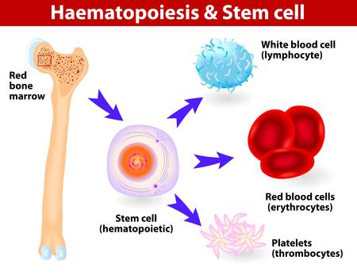
How Does a Bone Marrow Transplant Work?
Stem cells in your bone marrow make all your other blood cells
Notes:
Image is screen shot from the NE& Y HCC website, update to include. IBHO also open at SHT and now opened FLORAL trial.

Slide 85
How Does a Bone Marrow Transplant Work?
Stem cells in your bone marrow make all your other blood cells
Notes:
Image is screen shot from the NE& Y HCC website, update to include. IBHO also open at SHT and now opened FLORAL trial.

Slide 86
How Does a Bone Marrow Transplant Work?
Stem cells in your bone marrow make all your other blood cells
Notes:
Image is screen shot from the NE& Y HCC website, update to include. IBHO also open at SHT and now opened FLORAL trial.

Slide 87
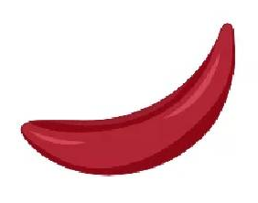
How Does a Bone Marrow Transplant Work?
Stem cells in your bone marrow make all your other blood cells
Notes:
Image is screen shot from the NE& Y HCC website, update to include. IBHO also open at SHT and now opened FLORAL trial.

Slide 88
How Does a Bone Marrow Transplant Work?
Sickle cell is caused by a genetic change in your stem cells
Notes:
Image is screen shot from the NE& Y HCC website, update to include. IBHO also open at SHT and now opened FLORAL trial.

Slide 89
How Does a Bone Marrow Transplant Work?
If we can replace your stem cells with healthy stem cells from a donor…
Notes:
Image is screen shot from the NE& Y HCC website, update to include. IBHO also open at SHT and now opened FLORAL trial.

Slide 90
How Does a Bone Marrow Transplant Work?
This can cure sickle cell if the transplant is successful
Notes:
Image is screen shot from the NE& Y HCC website, update to include. IBHO also open at SHT and now opened FLORAL trial.

Slide 91
What are the Downsides to Bone Marrow Transplant?
Chemotherapy (or similar) to remove your own stem cells
Time in hospital, sometimes long recovery
Risk of damage to organs
Affects fertility (options available to help)
Safest in young children – less safe for older people
Risk that donor cells attack your body (graft versus host disease)
Does not always work
Notes:
Image is screen shot from the NE& Y HCC website, update to include. IBHO also open at SHT and now opened FLORAL trial.

Slide 92
Who Might be Offered Bone Marrow Transplant? Children
Severe sickle cell disorder:
Still having frequent crises even with hydroxycarbamide
(4 or more per year needing to come to hospital
or affecting schooling)
2 or more chest crises even with hydroxycarbamide
Sickle cell has caused a stroke or other problems with brain health
Donor: matched healthy family member or can sometimes use half-match family member or unrelated donor
Notes:
Image is screen shot from the NE& Y HCC website, update to include. IBHO also open at SHT and now opened FLORAL trial.

Slide 93
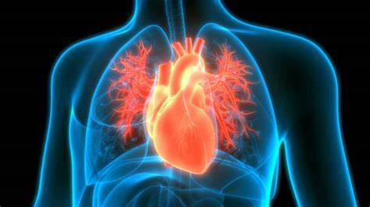
Who Might be Offered Bone Marrow Transplant? Adults
Severe sickle cell disorder:
3 or more severe crises per year despite hydroxycarbamide
2 or more chest crises despite hydroxycarbamide
Needing regular blood transfusions
Sickle cell has caused organ damage such as stroke
Fit enough to receive the transplant
Fully matched family donor (brother or sister)
Notes:
Image is screen shot from the NE& Y HCC website, update to include. IBHO also open at SHT and now opened FLORAL trial.

Slide 94
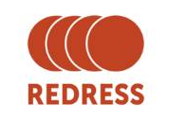
REDRESS Clinical Trial
Clinical trial
Open in Sheffield for people in NE&Y
For adults who need a transplant but don’t have a matched family donor
‘Haploidentical’ = half matched family members as donors
50 / 50 chance : transplant or standard treatment
Notes:
Image is screen shot from the NE& Y HCC website, update to include. IBHO also open at SHT and now opened FLORAL trial.

Slide 95
What is it Like for the Donor?
Blood test (usually) to see if they are a match
Checks to make sure they are well and can donate safely
3. Injections to stimulate the stem cells for a few days
4. Stem cells collected from the vein, or from the hip bones (a short procedure under anaesthetic)
Notes:
Image is screen shot from the NE& Y HCC website, update to include. IBHO also open at SHT and now opened FLORAL trial.

Slide 96
Gene Therapy
What is it and who is it for?

Slide 97
Gene Therapy
Also called:
Genome editing
Exa-cel
Casgevy®
Available since January 2025 for people aged 12 years +
Notes:
Image is screen shot from the NE& Y HCC website, update to include. IBHO also open at SHT and now opened FLORAL trial.

Slide 98
How Does Gene Therapy Work?
Uses your own stem cells
Alters your genes to make more fetal haemoglobin (HbF)
Notes:
Image is screen shot from the NE& Y HCC website, update to include. IBHO also open at SHT and now opened FLORAL trial.

Slide 99
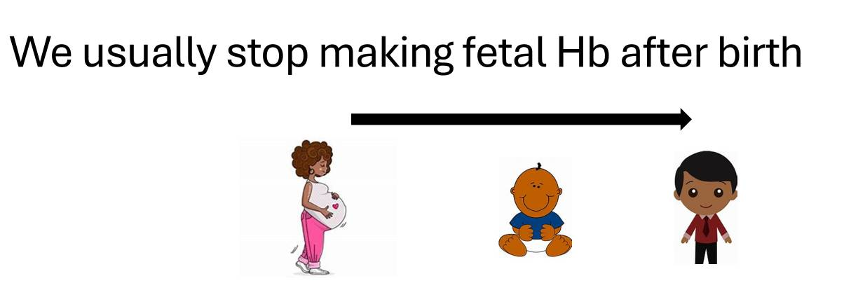
How Does Gene Therapy Work?
Uses your own stem cells
Alters your genes to make more fetal haemoglobin (HbF)
Fetal Hb
Adult (sickle) Hb
Notes:
Image is screen shot from the NE& Y HCC website, update to include. IBHO also open at SHT and now opened FLORAL trial.

Slide 100
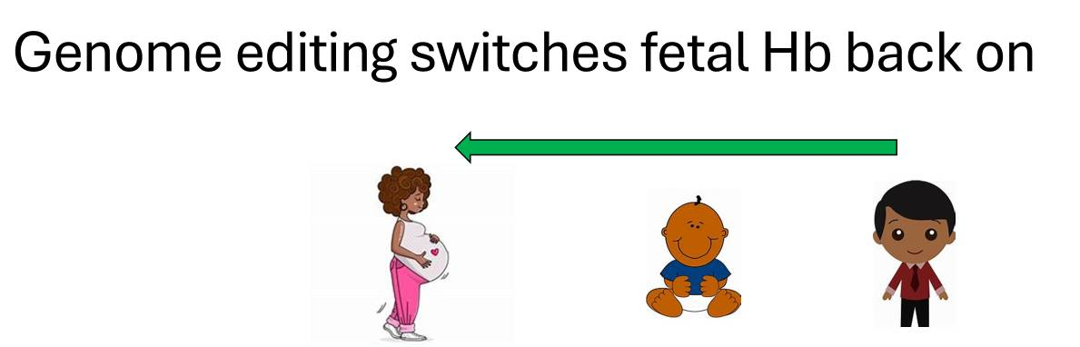
How Does Gene Therapy Work?
Uses your own stem cells
Alters your genes to make more fetal haemoglobin (HbF)
Fetal Hb
Adult (sickle) Hb
Notes:
Image is screen shot from the NE& Y HCC website, update to include. IBHO also open at SHT and now opened FLORAL trial.

Slide 101
How Does Gene Therapy Work?
Uses your own stem cells
Alters your genes to make more fetal haemoglobin (HbF)
More HbF helps to prevent crises
Fetal Hb
Adult (sickle) Hb
Notes:
Image is screen shot from the NE& Y HCC website, update to include. IBHO also open at SHT and now opened FLORAL trial.

Slide 102
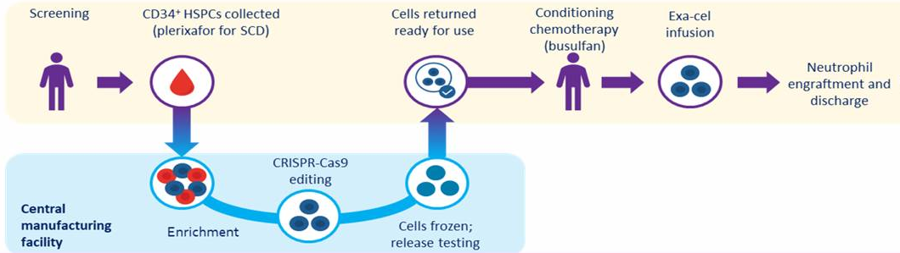
What is it Like to have Gene Therapy?
Frangoul et al, 2024
Notes:
Image is screen shot from the NE& Y HCC website, update to include. IBHO also open at SHT and now opened FLORAL trial.

Slide 103
What is it Like to have Gene Therapy?
Screening: making sure the treatment is suitable for you
Check you don’t have a matched family donor for bone marrow transplant
Review how often you have crises and any other complications
Check you are fit enough to manage the treatment
Making sure you have all the right information to make a decision
Frangoul et al, 2024
Notes:
Image is screen shot from the NE& Y HCC website, update to include. IBHO also open at SHT and now opened FLORAL trial.

Slide 104
What is it Like to have Gene Therapy?
Collecting your stem cells:
Injection to stimulate your stem cells to come out of bone marrow
Stem cells collected from your vein (like red cell exchange)
Often takes multiple times to successfully collect enough
Frangoul et al, 2024
Notes:
Image is screen shot from the NE& Y HCC website, update to include. IBHO also open at SHT and now opened FLORAL trial.

Slide 105
What is it Like to have Gene Therapy?
Waiting:
Wait usually 6 months or could be longer
Keep going with your normal treatment
Fertility preservation might take place
Frangoul et al, 2024
Notes:
Image is screen shot from the NE& Y HCC website, update to include. IBHO also open at SHT and now opened FLORAL trial.

Slide 106
What is it Like to have Gene Therapy?
Receiving the modified stem cells:
Stay in hospital usually 4-6 weeks
Strong chemotherapy given then the Exa-cel (stem cells)
Wait until your blood counts recover then you can go home
Frangoul et al, 2024
Notes:
Image is screen shot from the NE& Y HCC website, update to include. IBHO also open at SHT and now opened FLORAL trial.

Slide 107
What is it Like to have Gene Therapy?
Recovery:
See the specialist team regularly
Probably 6 – 12 months for complete recover (think about work or study requirements – can you do some from home? Financial support?)
Frangoul et al, 2024
Notes:
Image is screen shot from the NE& Y HCC website, update to include. IBHO also open at SHT and now opened FLORAL trial.

Slide 108
What are the Benefits of Gene Therapy?
Most people who had gene therapy on the clinical trial did not have crises after treatment
- 43/45 people had no pain for at least 12 months
- 45/45 people had at 12 months + out of hospital
- After treatment crises might still happen especially with
triggers such as infection or surgery
One-off treatment with probably long-term effect
CLIMB SCD-121 and CLIMB-131 clinical trials
Vertex, EHA 2025
Notes:
Image is screen shot from the NE& Y HCC website, update to include. IBHO also open at SHT and now opened FLORAL trial.

Slide 109
What are the Downsides of Gene Therapy?
Strong chemotherapy
  Time in hospital, sometimes long recovery
  Risk of damage to organs / life-threatening complications
  Affects fertility (options available to help)
Only currently available for age 12 years + (Clinical trial looking at treatment for younger children)
First person treated 6 years ago – we don’t have long term
data
Notes:
Image is screen shot from the NE& Y HCC website, update to include. IBHO also open at SHT and now opened FLORAL trial.

Slide 110
Who Might be Offered Gene Therapy?
Severe sickle cell disorder:
- Frequent crises needing medical attention
(2 or more per year for 2 years)
No matched family donor
Age 12+ (for older adults needs careful consideration)
Gene therapy treatment currently delivered in Manchester for North of England
Notes:
Image is screen shot from the NE& Y HCC website, update to include. IBHO also open at SHT and now opened FLORAL trial.

Slide 111


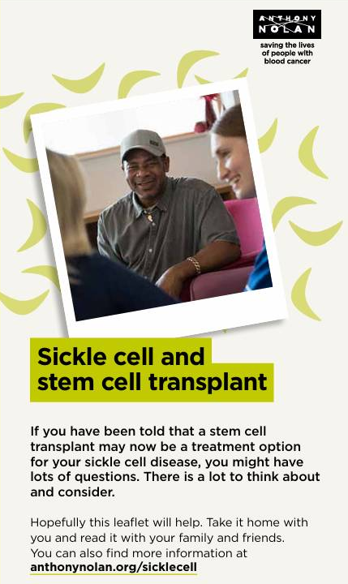

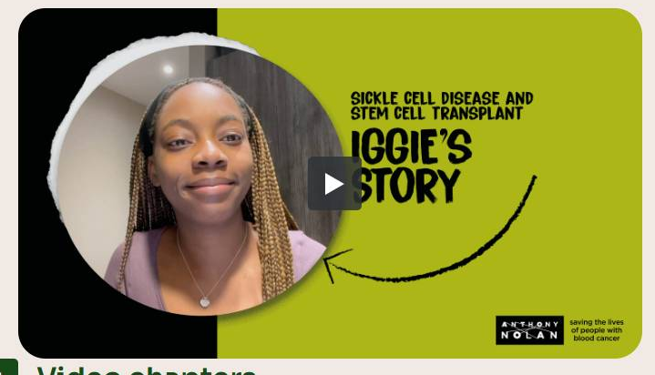
Where Can I Find More Information about Bone Marrow Transplant and Gene Therapy?
Healthcare Team
Notes:
Image is screen shot from the NE& Y HCC website, update to include. IBHO also open at SHT and now opened FLORAL trial.

Slide 112
Clinical Trials

Slide 113
Why do We Need Clinical Trials in Sickle Cell?
We need more treatments for sickle cell:
  Only 4 new treatments approved for sickle cell in the UK in over 20 years – 2 since withdrawn
  Transplant and gene therapy are not right for everyone
  More choices and better treatment options needed
Clinical trials can offer access to new (experimental) treatments
Clinical trials are the only way to gain more knowledge and better treatment options
Notes:
Image is screen shot from the NE& Y HCC website, update to include. IBHO also open at SHT and now opened FLORAL trial.

Slide 114
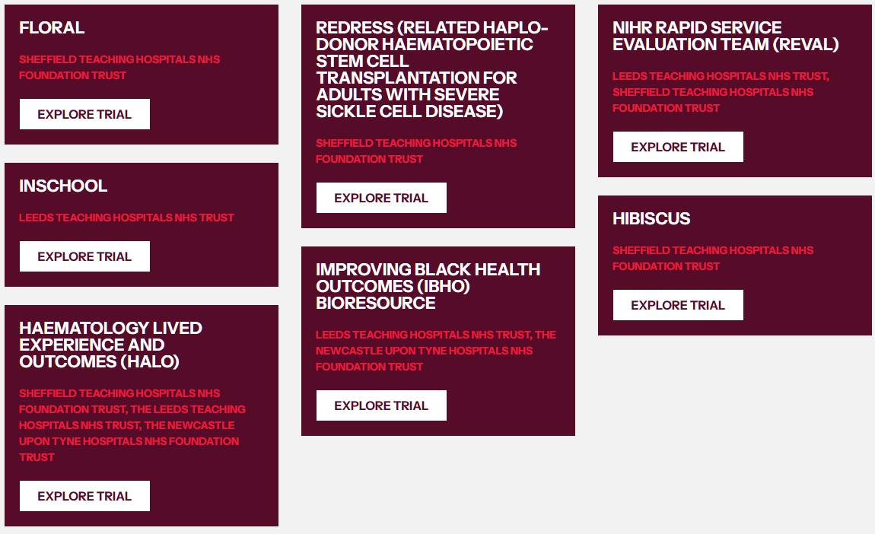
Clinical Trials in the NE&Y Region https://www.ney-hcc.co.uk/research-projects/

Slide 115

Questions and Discussion

Slide 116

Close
Feedback
QR codes on tables
Food Parcels
16:20 | Newcastle Arrange to leave to be on coaches - collect food for journey home
16:30 | Leeds Arrange to leave to be on coaches - collect food for journey home
16:40 | Sheffield Collect food parcel

